Slide 1
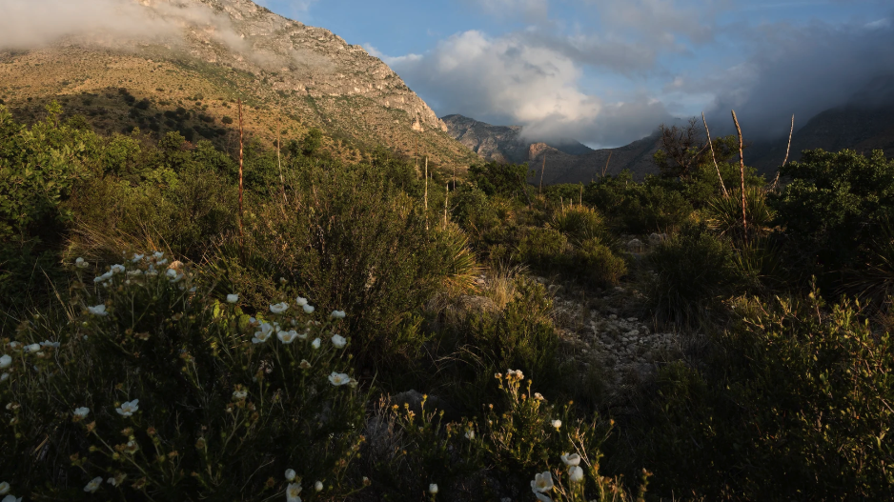
Plants aren’t dumb Using optimality theory to understand big questions in plant ecophysiology
Nick Smith
Department of Biological Sciences
Texas Tech University
nick.smith@ttu.edu

Slide 2
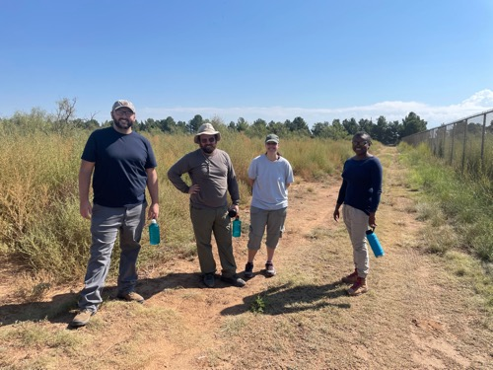
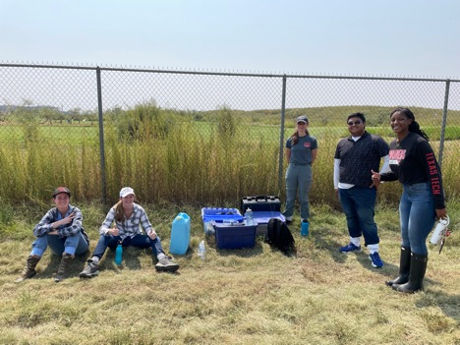
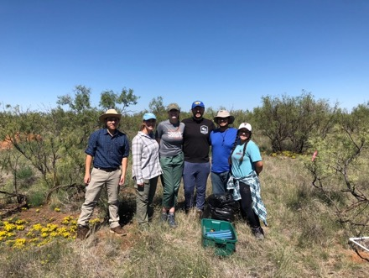






Acknowledgements
Current and former lab members
Alissar Cheaib (postdoc)
Evan Perkowski (postdoc)
Snehanjana Chatterjee (PhD)
Monika Kelley (PhD)
Isabella Beltran (PhD)
Daniel Owusu Kwakye (PhD)
Garrison Garza (PhD)
Christine Vanginault (MS; graduating Thursday!)
Zinny Ezekannagha (MS)
Clara Drake (MS)
Gwen Wattt (MS)
Brad Posch (postdoc; now at DBG)
Jeff Chieppa (postdoc; now in industry)
Lizz Waring (postdoc; now Asst. Prof at Northeastern State U)
Kieran Carroll (lab manager; now PhD student at OU)
Eve Gray (MS; now at UT-Austin)
Risa McNellis (MS; now at Plum Island LTER)
Helen Scott (MS; now in industry and PhD student at BU)
Too many (40) undergrads to list!
Collaborators around the world
Funding
NSF
USDA
NPS
USGS
Schmidt Futures
Texas EcoLab

Slide 3
Why do people care about plants?

Slide 4
Why do people care about plants?

Slide 5
Why do people care about plants?

Slide 6
Why do people care about plants?

Slide 7
Why do people care about plants?

Slide 8
Why do people care about plants?

Slide 9
Why do people care about plants?

Slide 10
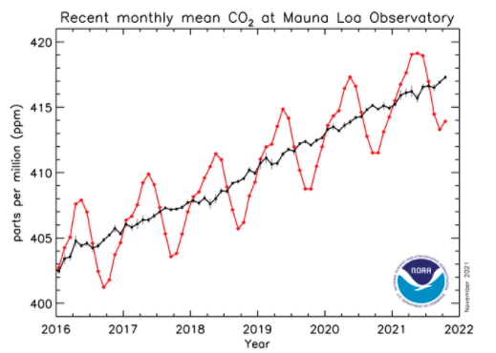
Why do people care about plants?

Slide 11
In other words: plants provide ecosystem services
FNAL

Slide 12
Including photosynthesis
FNAL

Slide 13
Photosynthesis provides the foundation for other services
FNAL

Slide 14
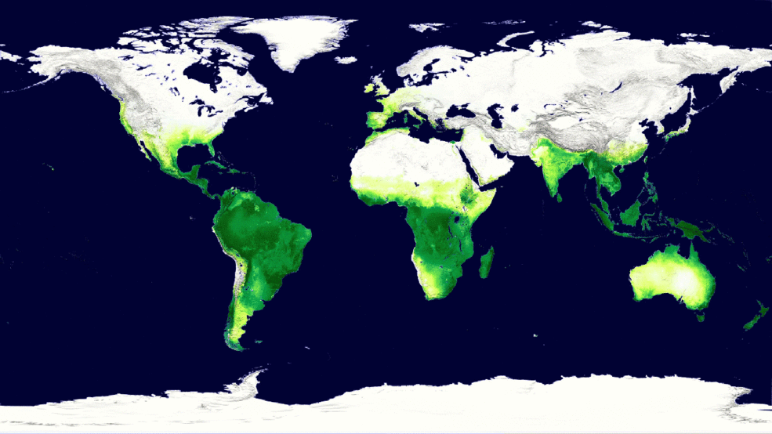
Photosynthesis is a dynamic process that is likely to be impacted by global change
MODIS, NASA

Slide 15
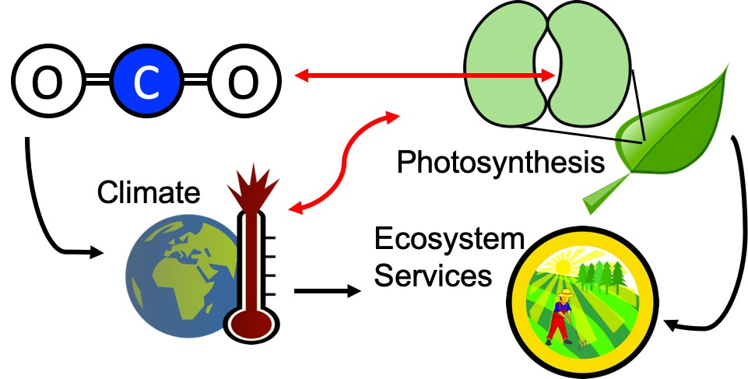
Our lab examines photosynthesis as a regulator of global change impacts on ecosystem services
Smith (2024) Am J Botany

Slide 16
Photosynthesis is important! An example…

Slide 17
Photosynthesis is important! An example…
Data from IPCC (2013)

Slide 18
Photosynthesis is important! An example…
Photosynthesis
Data from IPCC (2013)

Slide 19
Photosynthesis is important! An example…
Photosynthesis
A small percentage change in photosynthesis can have large consequences for climate
Data from IPCC (2013)

Slide 20
But predictions are uncertain!
Friedlingstein et al. (2014) J Climate

Slide 21
But predictions are uncertain!
Future model uncertainty (14 Pg) > current fossil fuel emissions (9.5 Pg)
Friedlingstein et al. (2014) J Climate

Slide 22
This uncertainty is driven by uncertainty in photosynthesis
Friedlingstein et al. (2014) J Climate
Keenan…Smith et al. (2023) Nature Climate Change

Slide 23
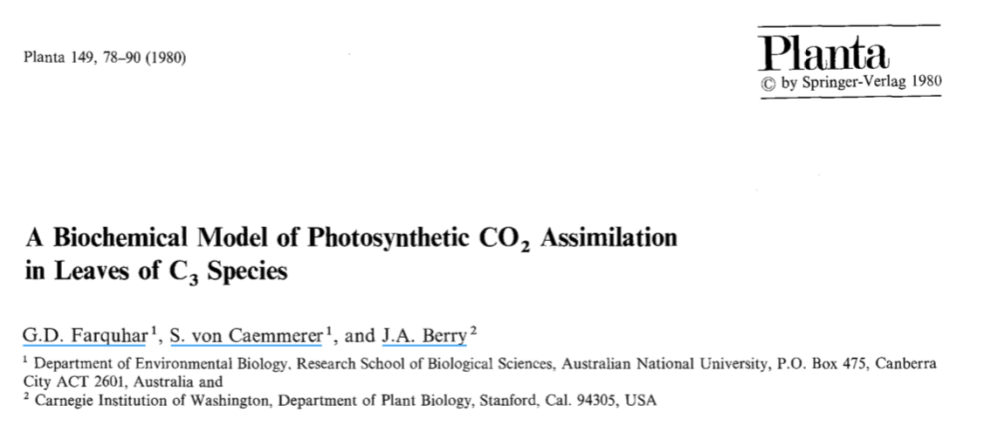
Why the uncertainty? Theoretical models for photosynthesis exist

Slide 24
These produce short term responses that match data

Slide 25
Why the uncertainty? Long-term responses differ from short-term responses due to acclimation

Slide 26
Dumb plants

Slide 27
Acclimation: an example
Acclimated to high light
Acclimated to low light

Slide 28
Acclimation: an example
Acclimated to high light
Acclimated to low light
Photosynthesis peaks a light level close to the level the leaf is acclimated to

Slide 29
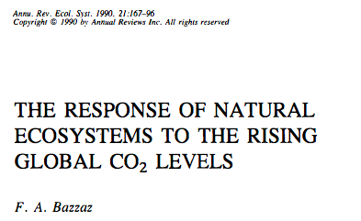
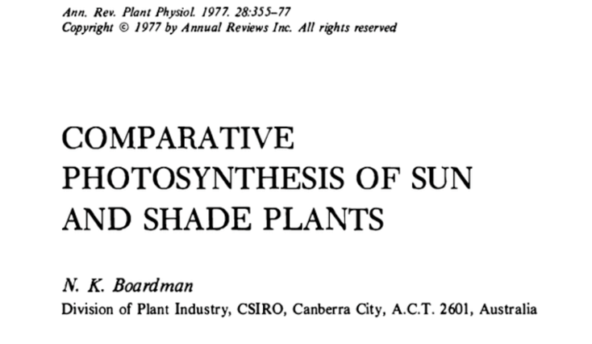
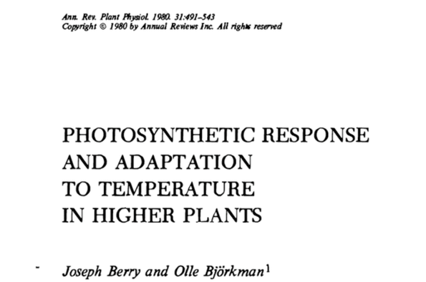
Acclimation is ubiquitous and well known…
Temperature: Berry & Björkman (1980)
CO₂: Bazzaz (1990)
Light: Boardman (1977)

Slide 30
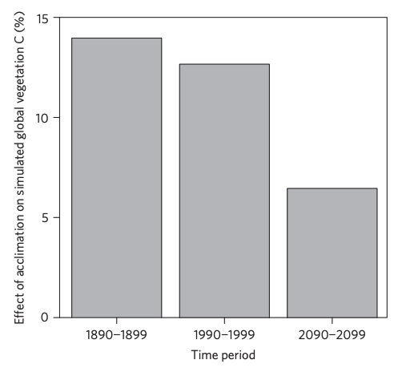
…and can impact carbon cycling and climate
Acclimation increase future C storage by ~6%
Acclimation alters future temperature by >1°C
Smith et al. (2017) Nature Climate Change
Smith et al. (2017) JAMES

Slide 31
Unfortunately, no theoretical model for photosynthetic acclimation exists

Slide 32
Lack of theory results in…

Slide 33
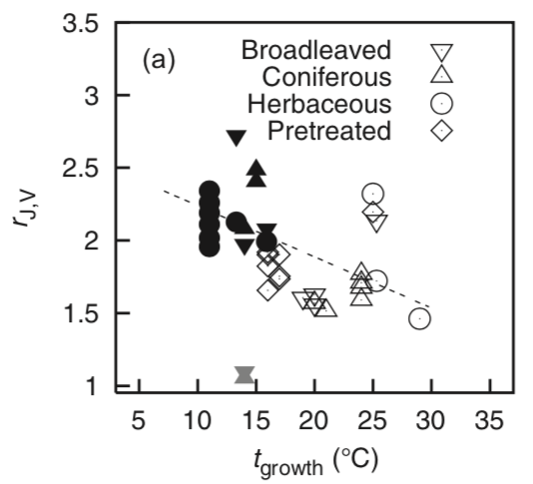
Lack of theory results in…
Unreliable future predictions (overparameterization, tuning)
Reliance on statistical models
Resulting change in simulated photosynthesis
Physiological parameter
Environmental condition
Kattge and Knorr (2007) PC&E
Smith et al. (2017) JAMES

Slide 34
Lack of theory results in…
Inability to test mechanisms
Resulting change in simulated photosynthesis
Physiological parameter
Environmental condition
Kattge and Knorr (2007) PC&E
Smith et al. (2017) JAMES

Slide 35
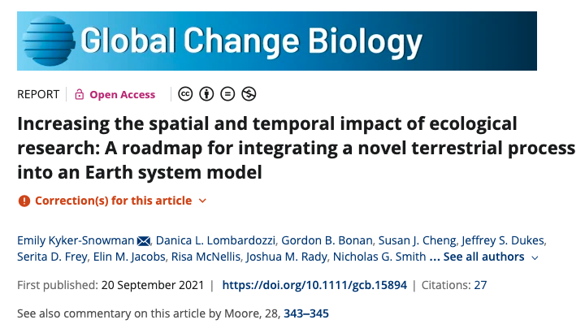
Lack of theory results in…
Inability to test mechanisms
Resulting change in simulated photosynthesis
Physiological parameter
Environmental condition
Kyker-Snowman,… Smith et al. (2022) Glob Change Biol

Slide 36
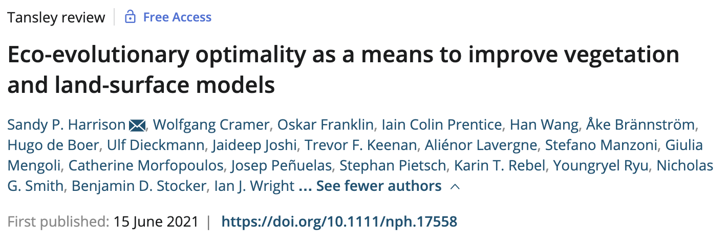
So, we developed a mechanistic model of photosynthetic acclimation Based on optimization and the first principles of plant physiological theory
Harrison,…Smith et al. (2021) New Phyt

Slide 37
Optimization: Least cost theory
Optimally, plants will maintain fastest rate of photosynthesis at the lowest summed resource cost (water and nutrient use)
Wright et al. (2003) Am Naturalist

Slide 38
Optimal photosynthesis
Photosynthesis = f{stomatal conductance,
photosynthetic biochemistry}

Slide 39
Optimal photosynthesis
Photosynthesis = f{stomatal conductance,
photosynthetic biochemistry}
Must predict optimal rates of both

Slide 40
Optimal photosynthesis
Photosynthesis = f{stomatal conductance,
photosynthetic biochemistry}
[TALK TO ME LATER ABOUT THIS IF YOU ARE INTERESTED]
Prentice et al. (2014) Ecol Letters; Wang et al. (2017) Nature Plants; Smith et al. (2019) Ecol Letters; Smith and Keenan (2020) Glob Change Biol

Slide 41
Optimal photosynthesis
Photosynthesis = f{stomatal conductance,
photosynthetic biochemistry}

Slide 42
Biochemistry optimization
Plant biochemistry setup will aim for equal limitation by all factors
[TALK TO ME LATER ABOUT THE MATHS]

Slide 43
Biochemistry trait The maximum rate of Rubisco carboxylation (V_{cmax})

Slide 44
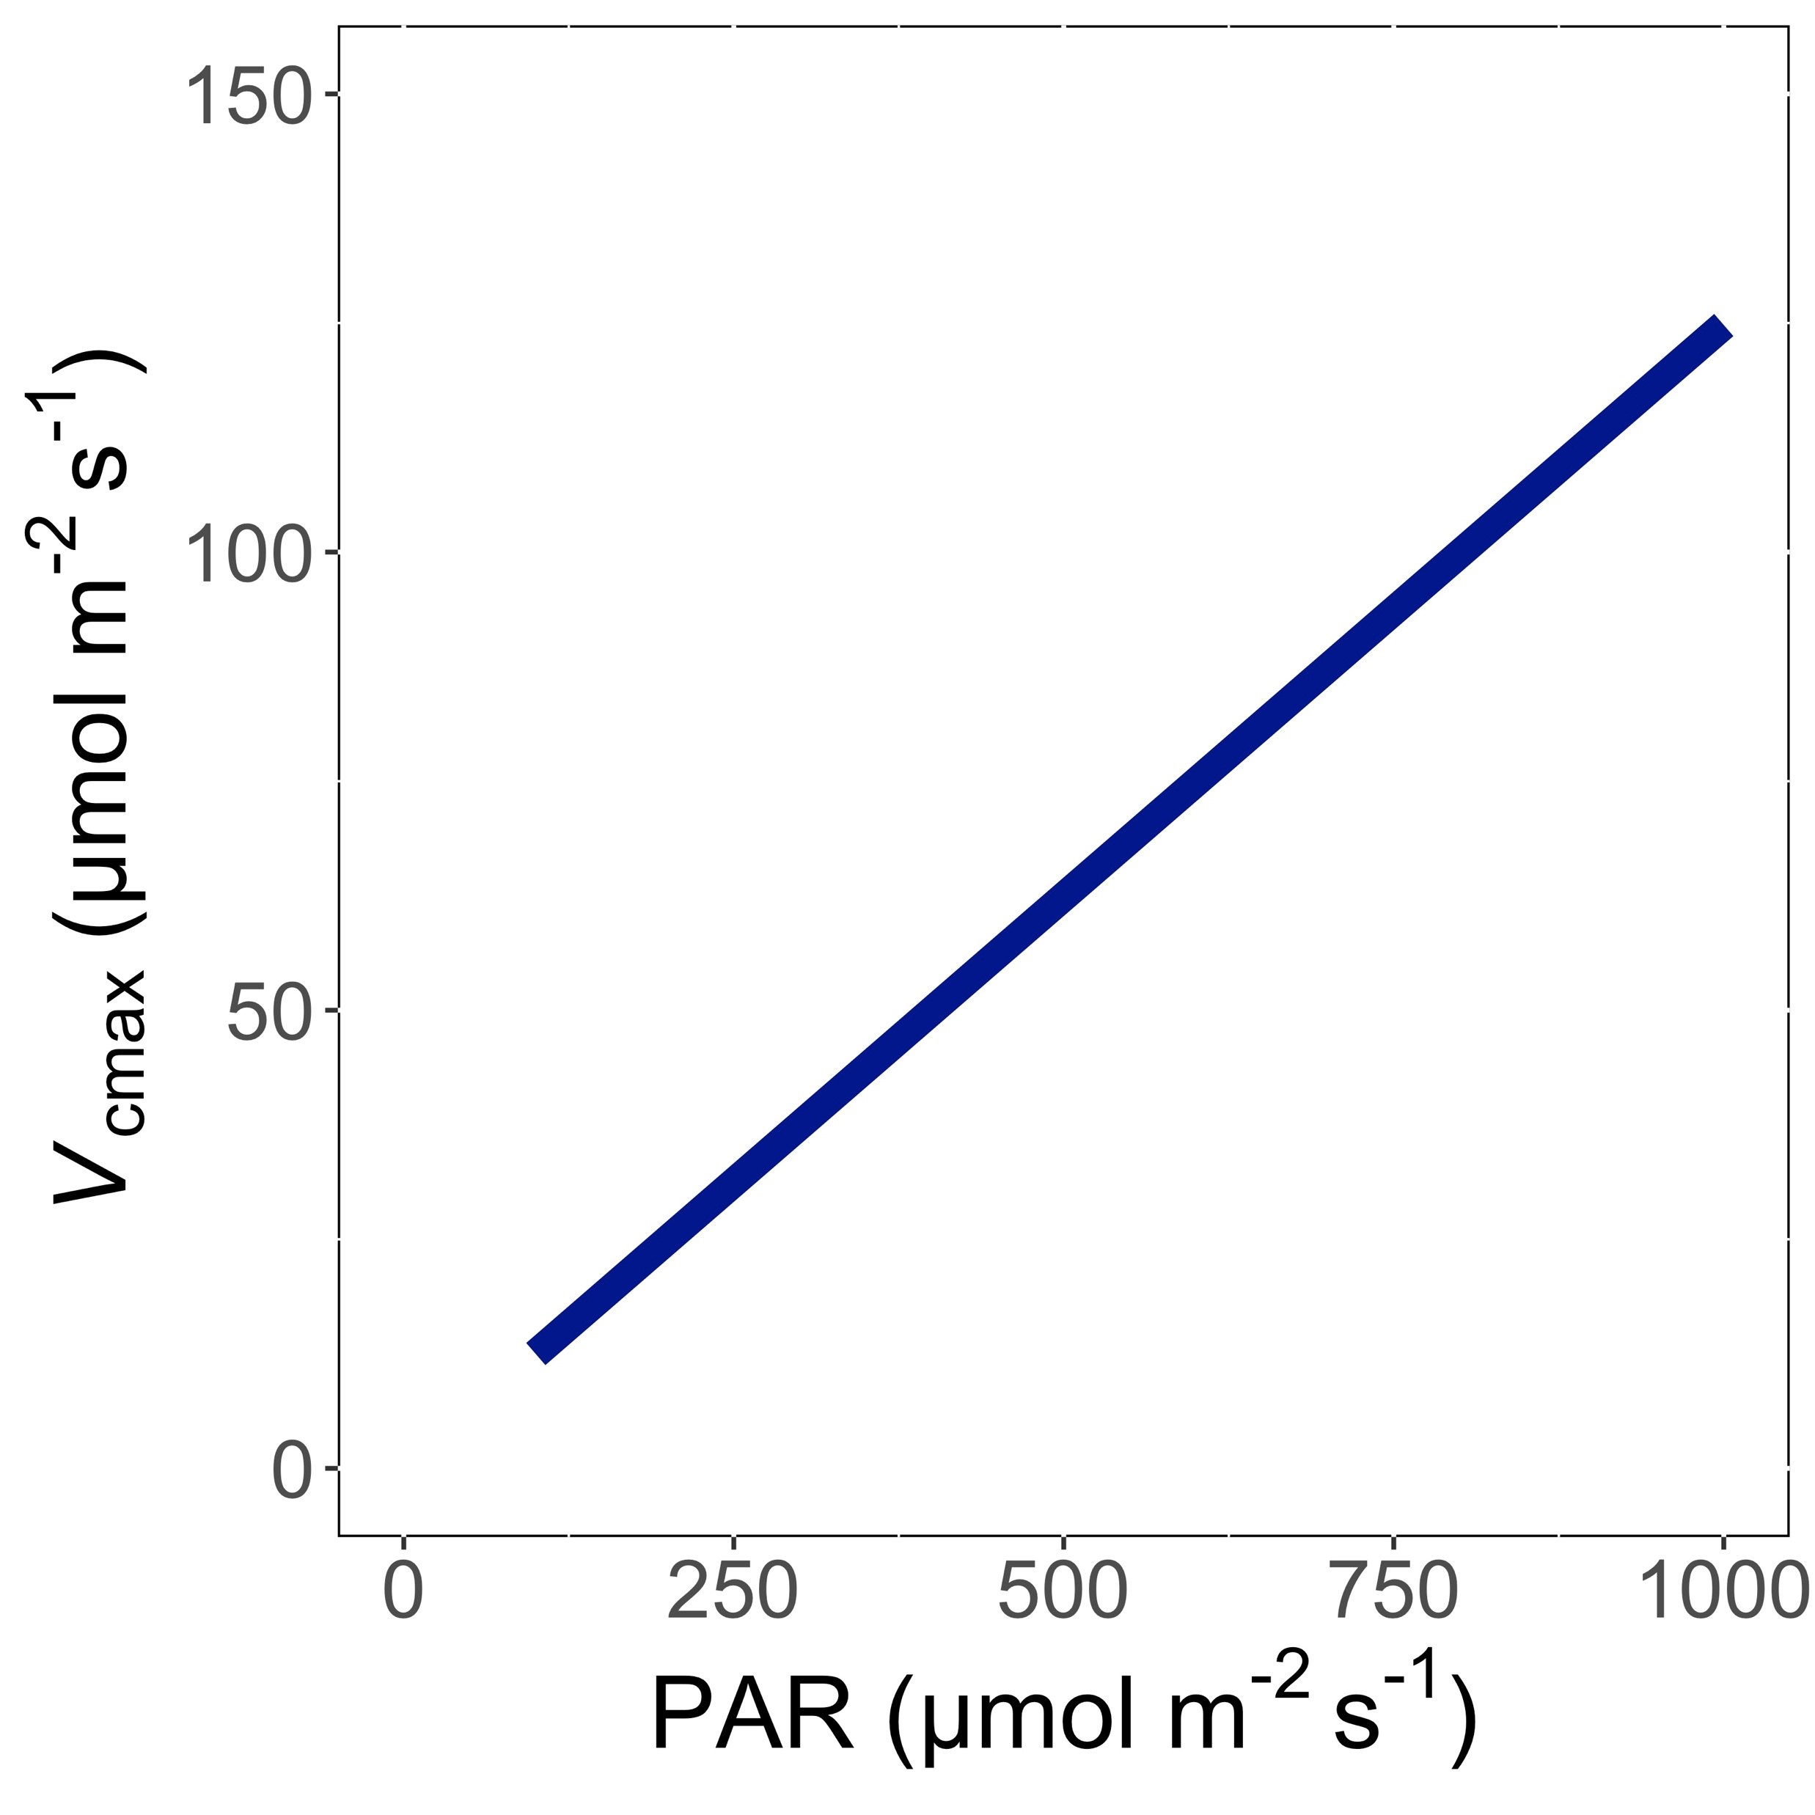
V_{cmax} increases with light because of greater electron transport
Smith et al. (2019) Ecol Letters; Smith and Keenan (2020) Glob Change Biology

Slide 45
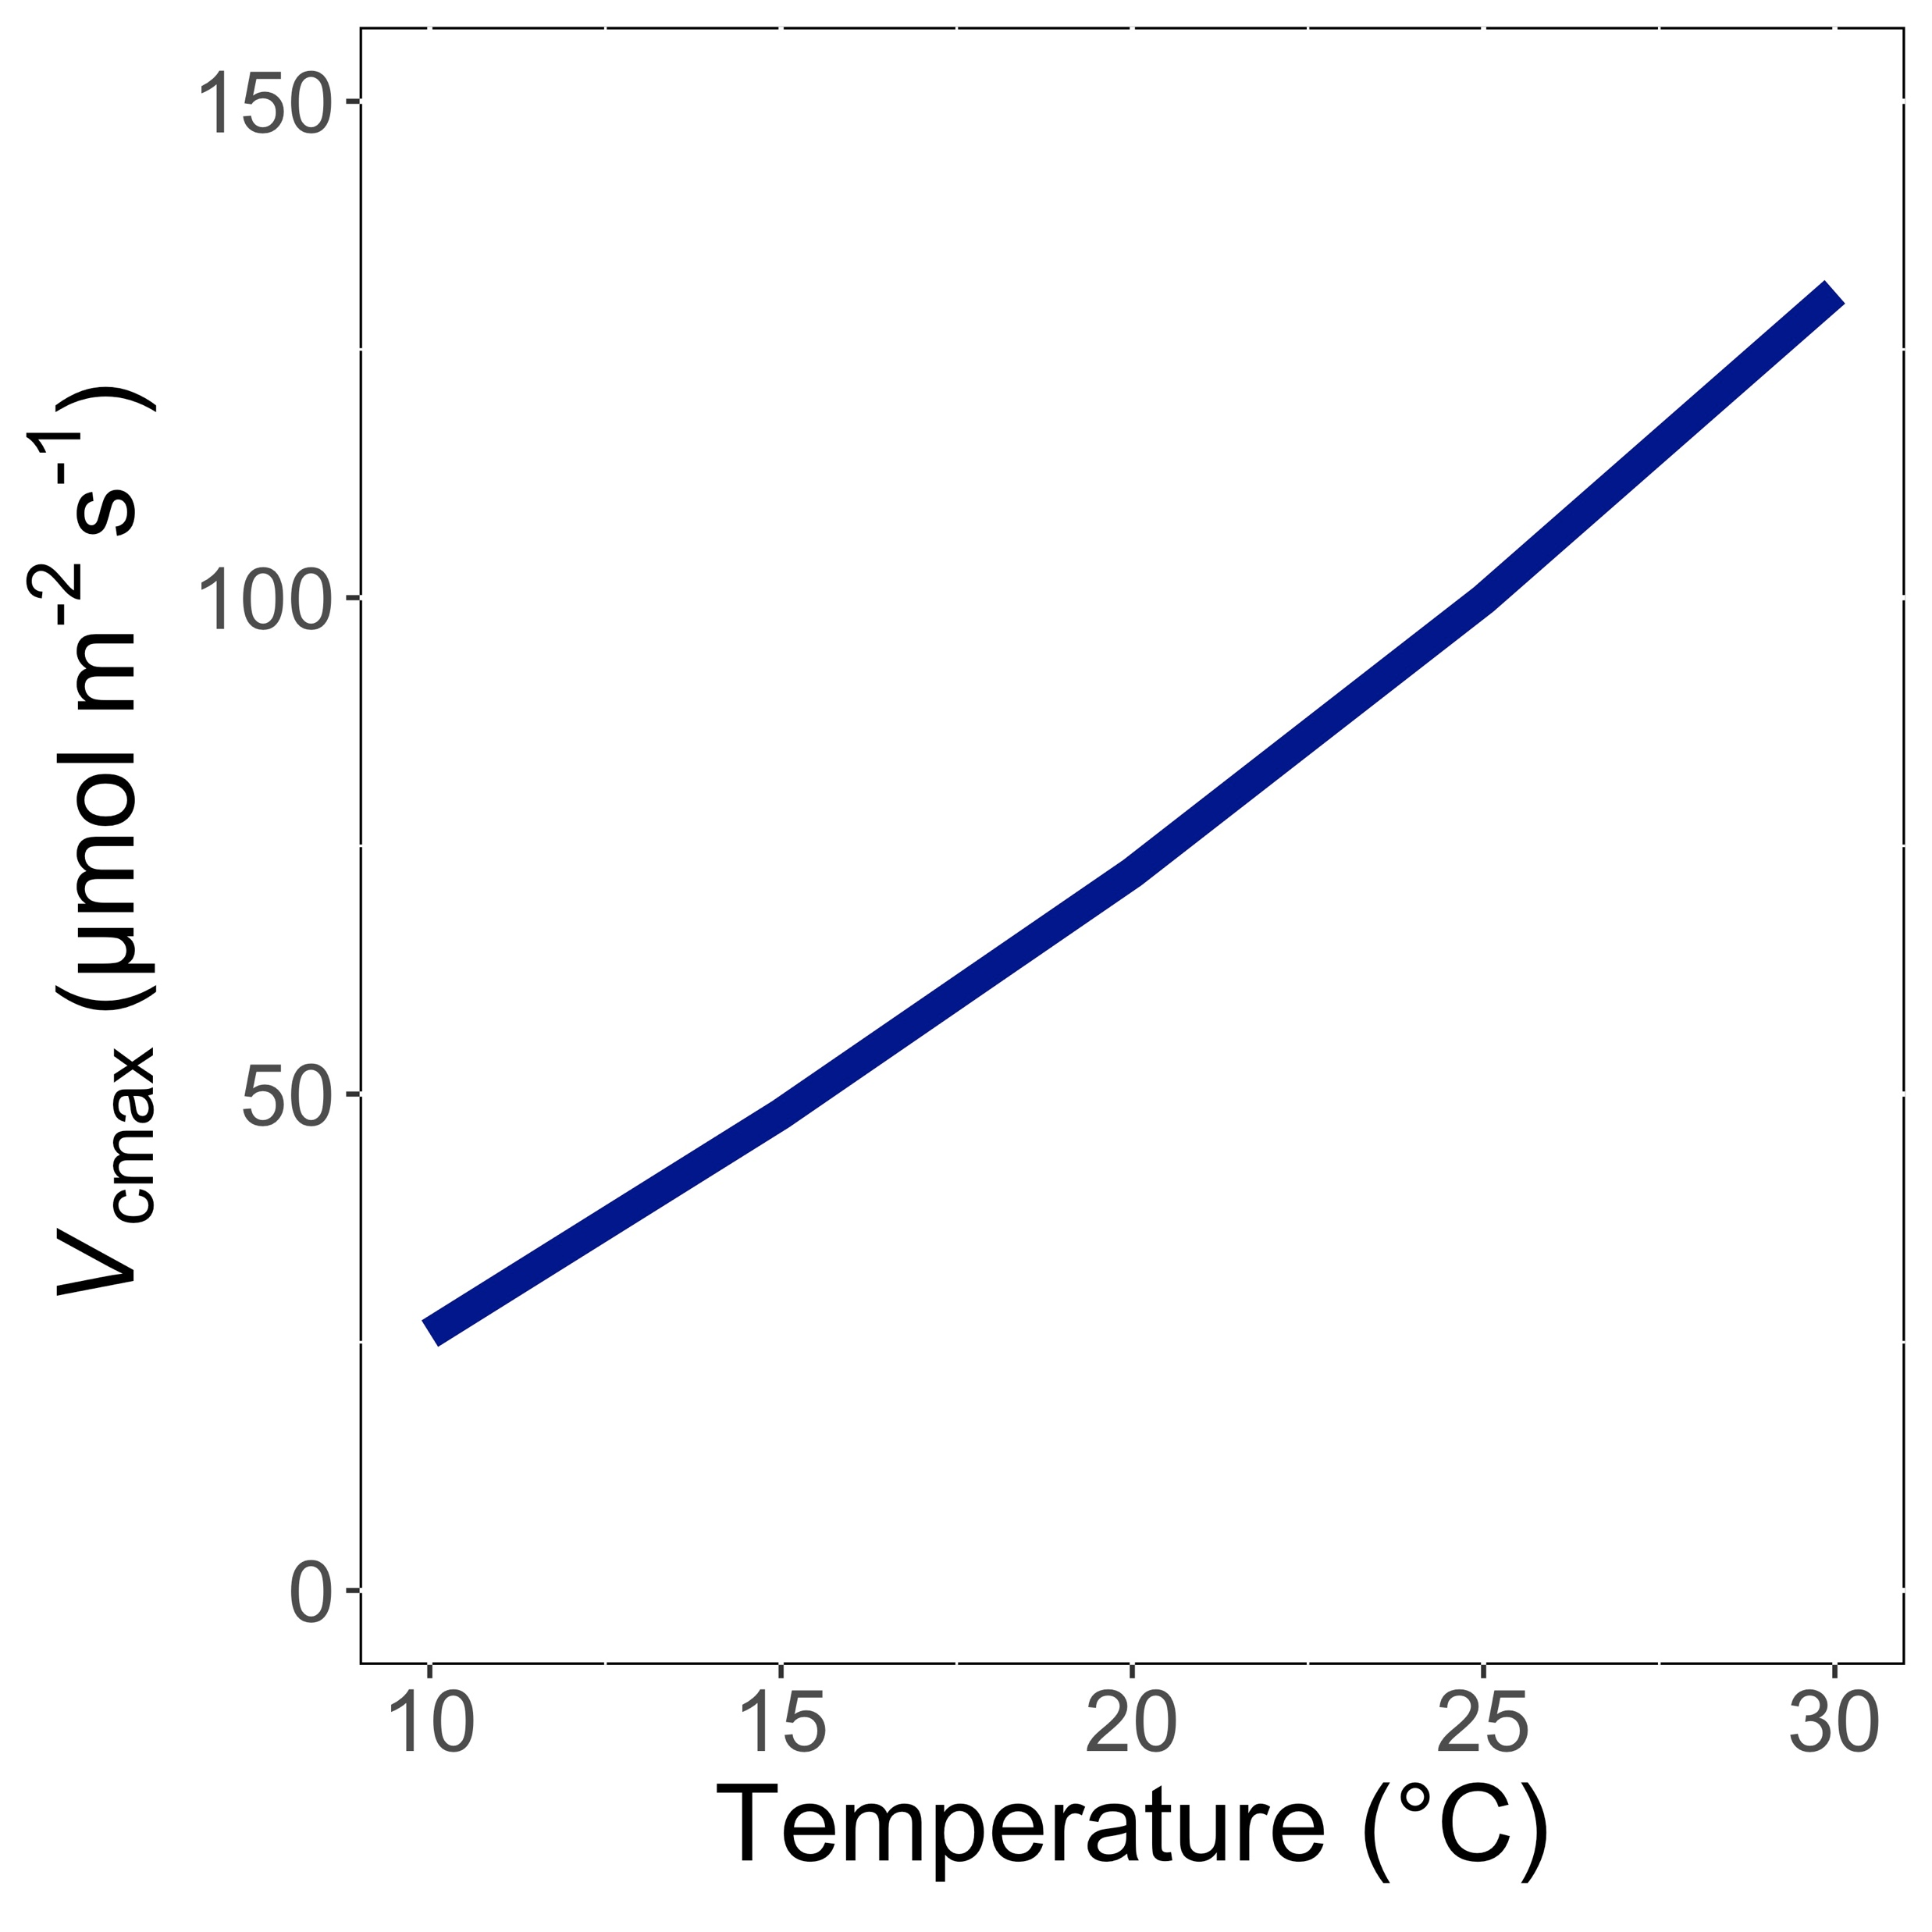
V_{cmax} increases with temperature because of greater electron transport and photorespiration
Smith et al. (2019) Ecol Letters; Smith and Keenan (2020) Glob Change Biology

Slide 46
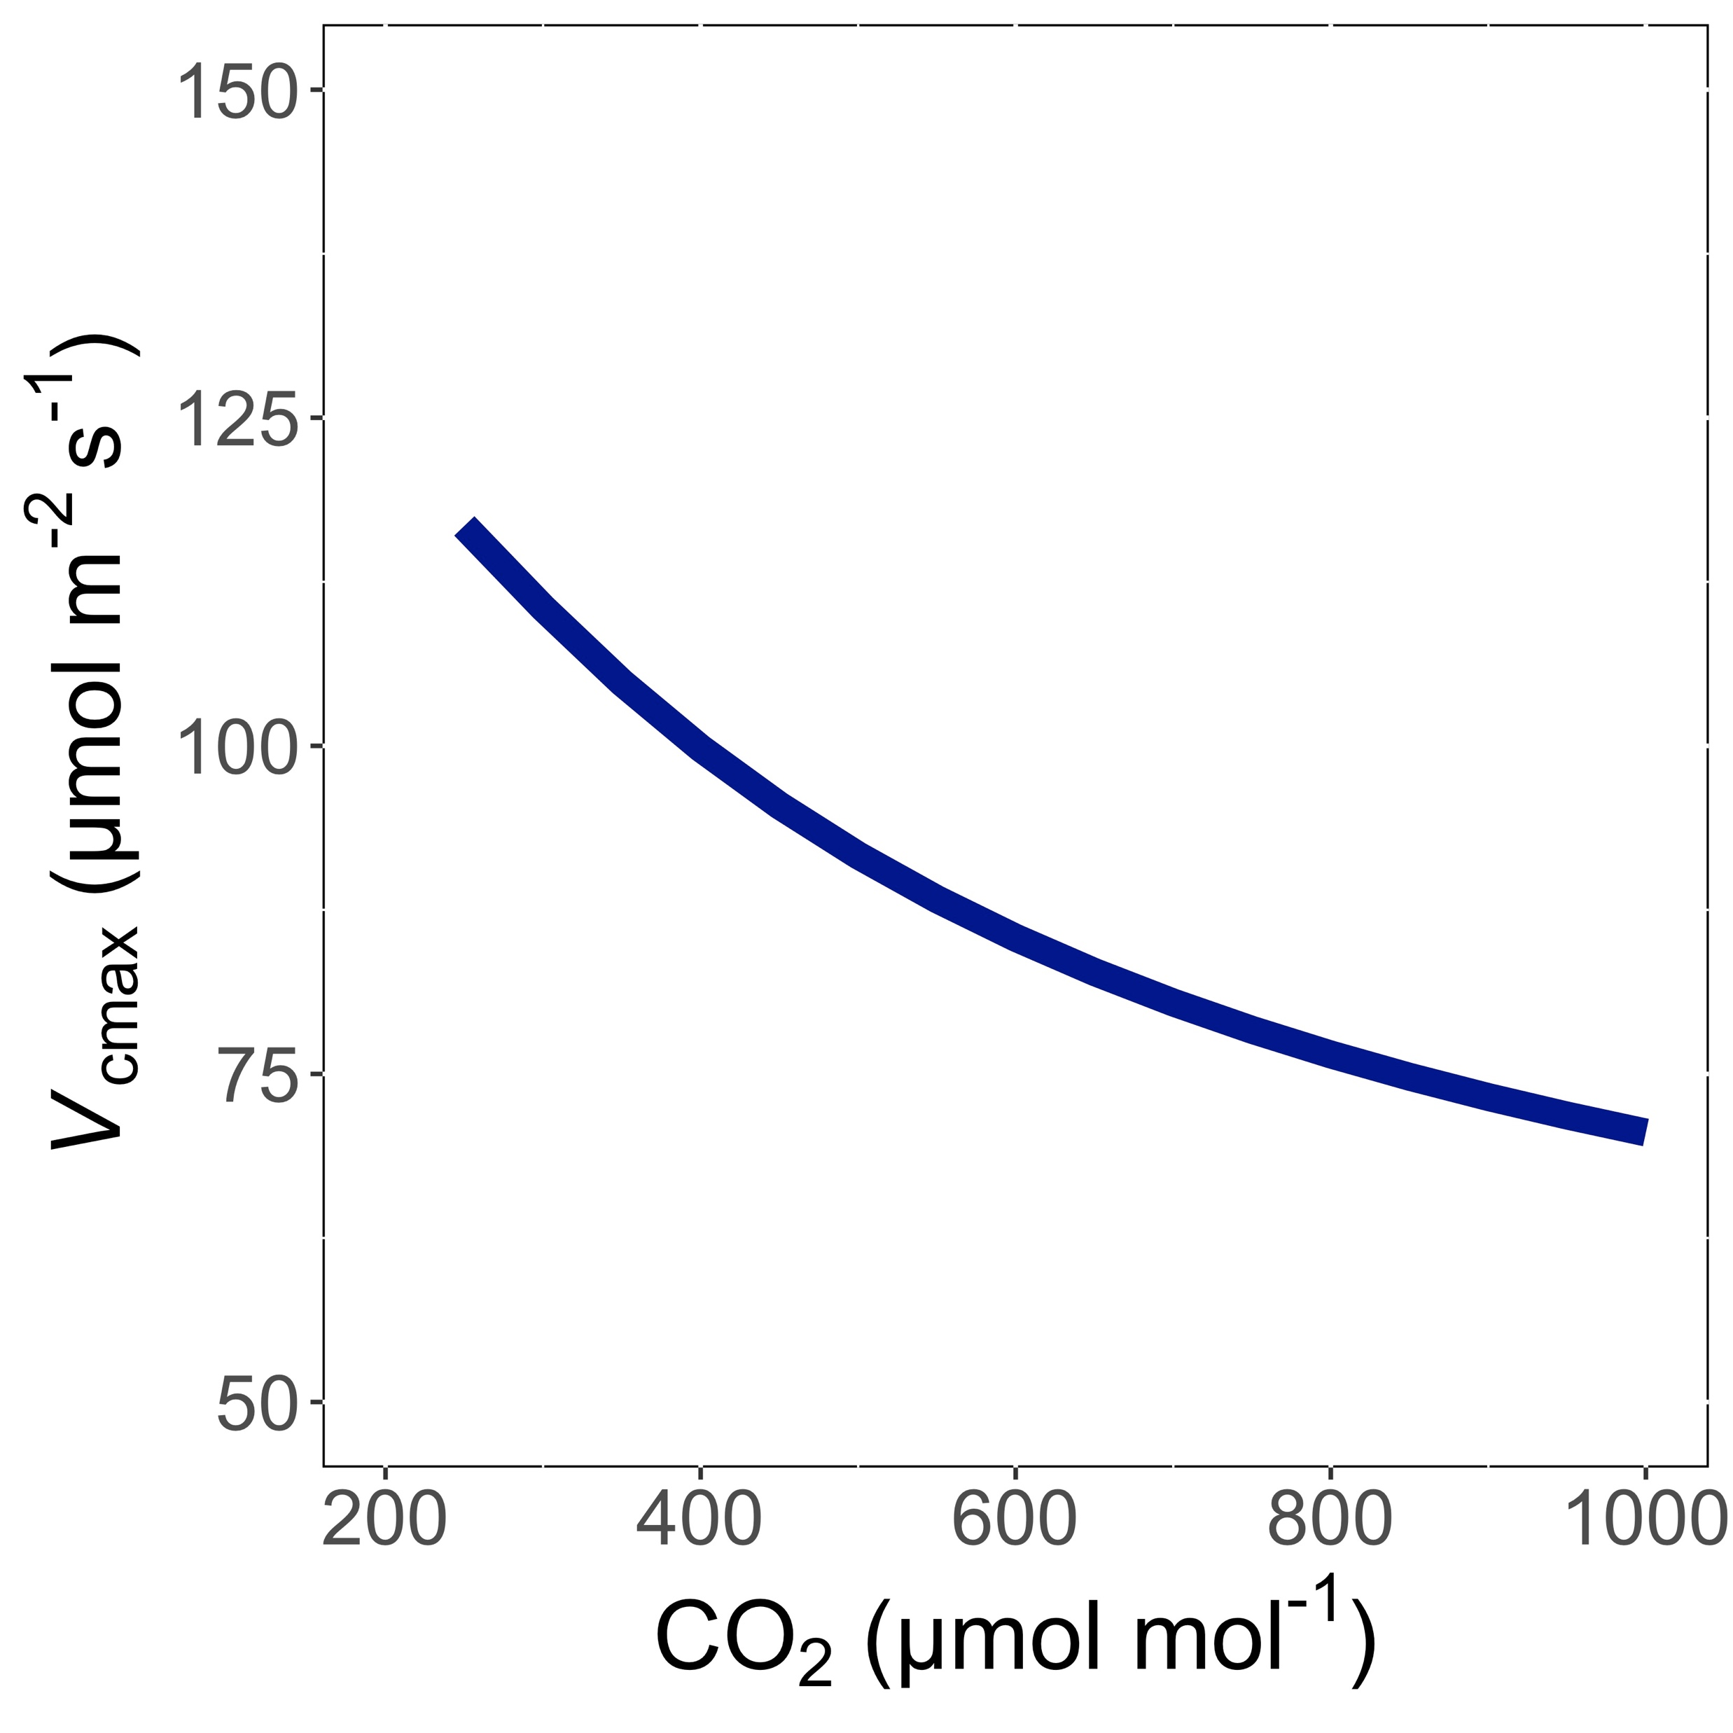
V_{cmax} decreases with CO₂ because of greater CO₂ in the leaf and less photorespiration
Smith et al. (2019) Ecol Letters; Smith and Keenan (2020) Glob Change Biology

Slide 47
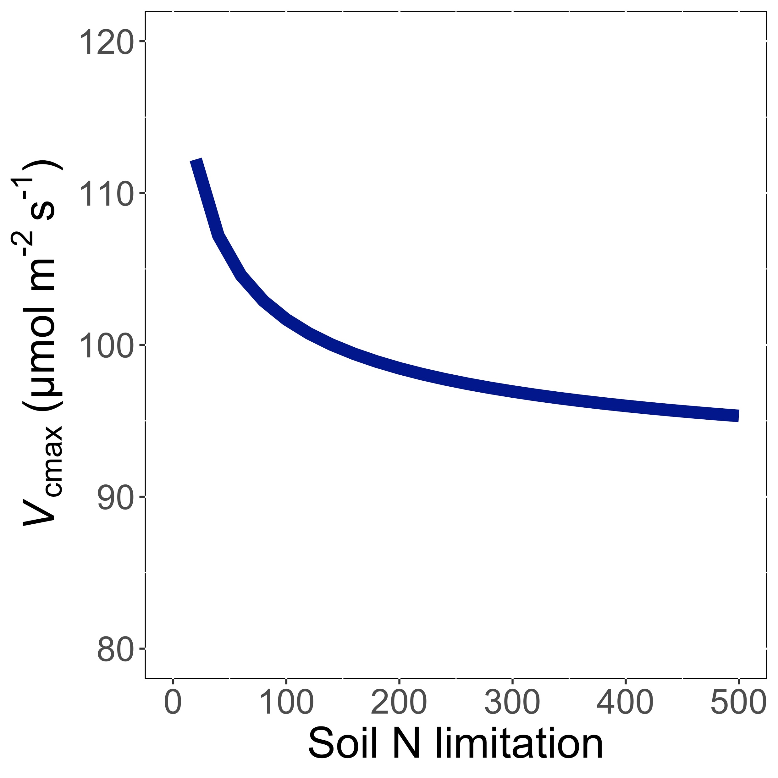
V_{cmax} decreases with soil N limitation because Rubisco requires a lot of N
Smith et al. (2019) Ecol Letters; Smith and Keenan (2020) Glob Change Biology

Slide 48
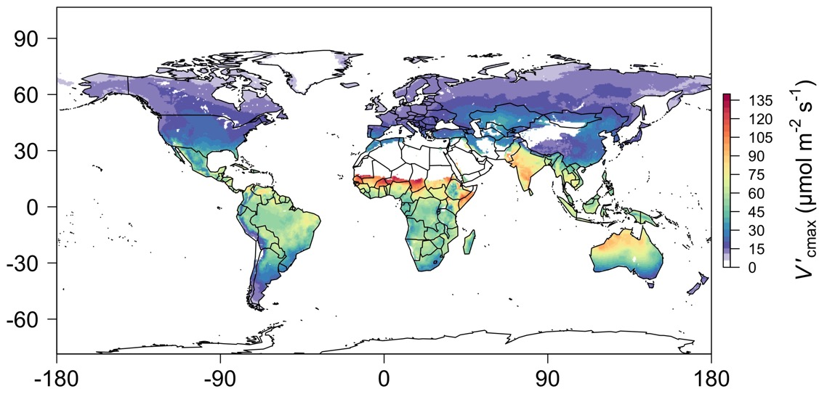
We can predict optimal traits in different environments
Smith et al. (2019) Ecology Letters

Slide 49
Ok, great, but now what?

Slide 50
We can use the theory as a null model to explore acclimation mechanisms

Slide 51
Let’s tackle some big questions in plant ecophysiology!

Slide 52
Big questions
Is photosynthesis optimized to the environment?
How do plants acclimate to soil nitrogen?
What does acclimation mean for future terrestrial biogeochemical cycling?
When is C₄ photosynthesis an advantage over C₃ photosynthesis?

Slide 53
Question 1: Is photosynthesis optimized to the environment?

Slide 54
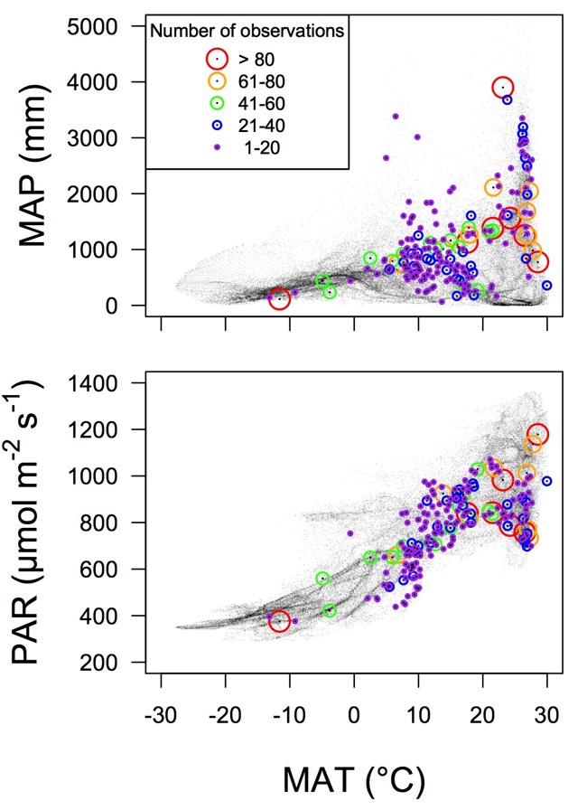
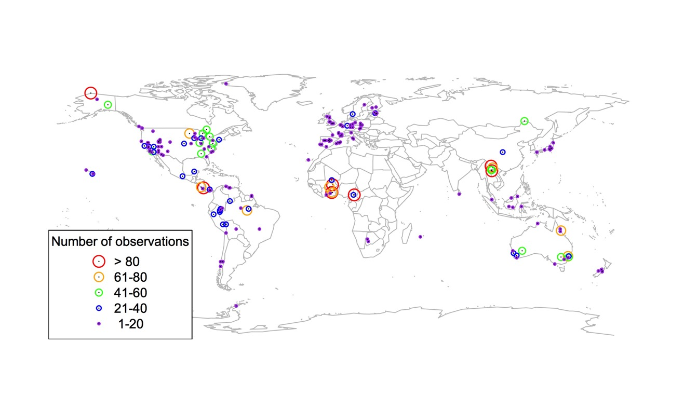
Global V_{cmax} dataset
3,697 measurements
202 sites
> 600 genera
Smith et al. (2019) Ecol Letters

Slide 55

Smith et al. (2019) Ecol Letters

Slide 56
Optimal V_{cmax} is similar to observed values
Smith et al. (2019) Ecol Letters

Slide 57
Question 1: Is photosynthesis optimized to the environment? YES! Photosynthesis acclimates spatially as expected from optimization

Slide 58

Looking forward: using theory to understand larger scale consequences of acclimation
As predicted from theory, increased leaf N confers greater species population growth in dry sites and this is enhanced by eutrophication.
Aridity
Cheaib,… and Smith (in prep)

Slide 59
Question 2: How do plants acclimate to soil nitrogen?

Slide 60
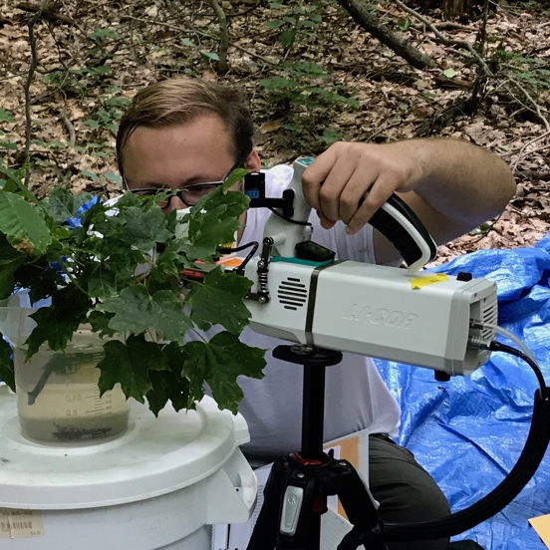


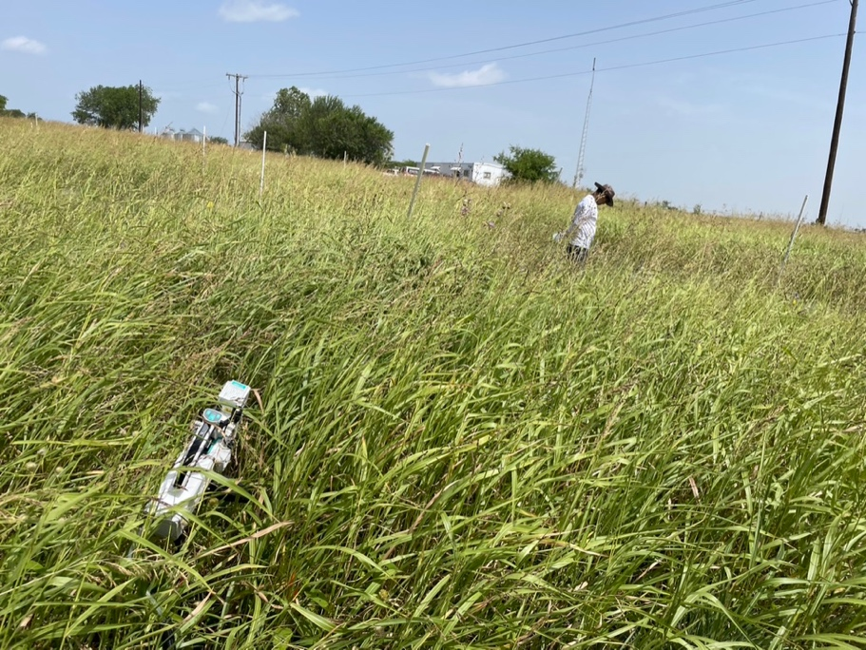
The lab has examined soil nitrogen impacts in many contexts
Observational gradient studies
Paillassa et al. (2020) New Phyt, Cheaib et al. (2025) New Phyt, Perkowski and Smith (in review), Cheaib, et al. (in prep)
Greenhouse soil manipulation studies
Perkowski et al. (2021) J Exp Botany, Waring et al. (2023) J Exp Botany, Perkowski et al. (2025) J Exp Botany
Field soil manipulation studies
Cheaib et al. (2025) Ecol Letters, Perkowski et al. (in review), Beltran Triana et al. (in prep)

Slide 61
What have we learned?

Slide 62
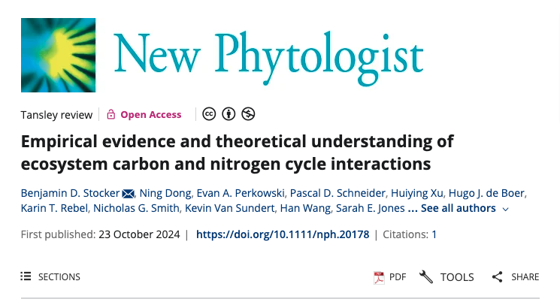
Stocker,…Smith et al. (2025) New Phyt

Slide 63
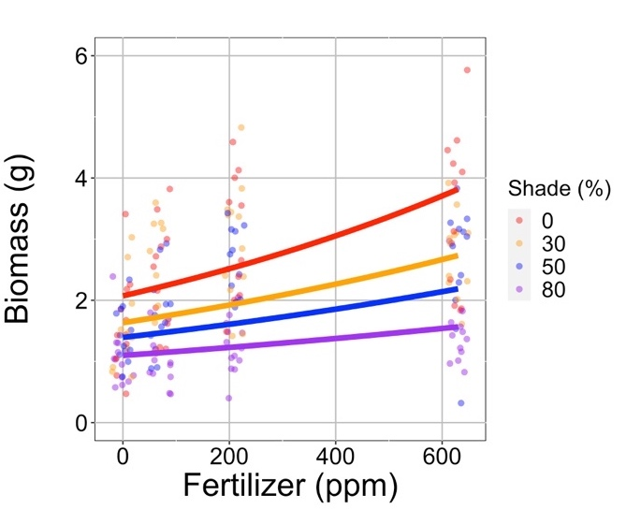
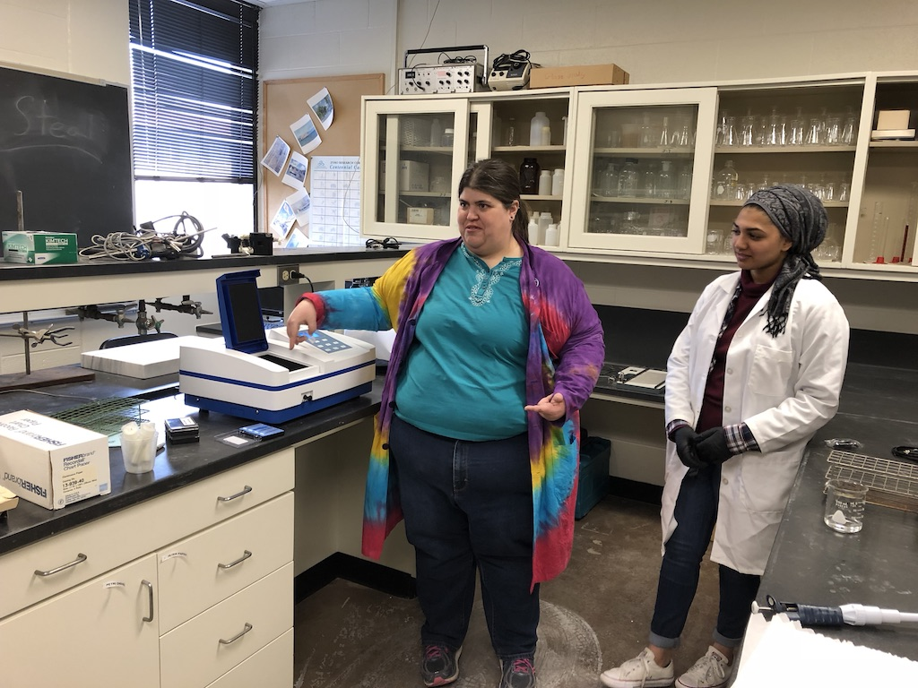
Result 1: Growth increases with increasing soil N
Waring, Perkowski, and Smith (2023) J Exp Botany

Slide 64
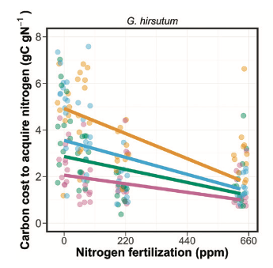

Result 2: C cost to acquire N decreases with increasing soil N
*Consistent across all studies at leaf and plant level
Perkowski, Waring, and Smith (2021) J Exp Botany

Slide 65
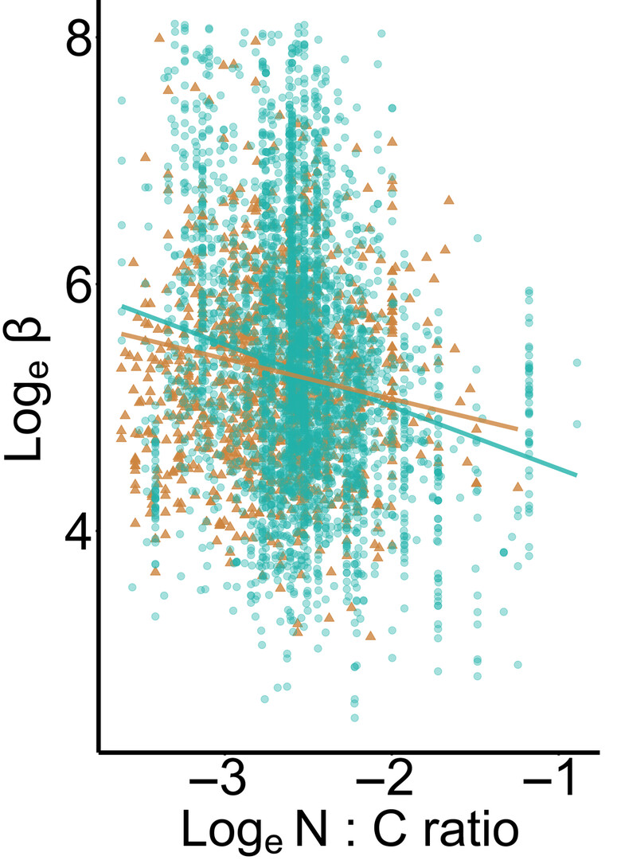
Result 2: C cost to acquire N decreases with increasing soil N
*Consistent across all studies at leaf and plant level
Cheaib, Chieppa, Perskowski, and Smith (2025) New Phytologist

Slide 66
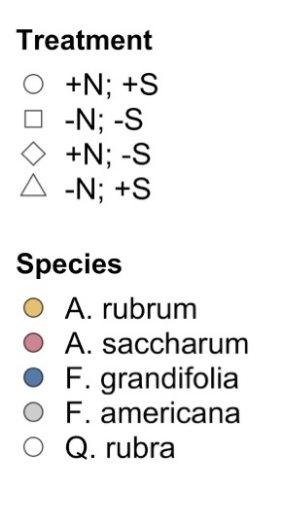
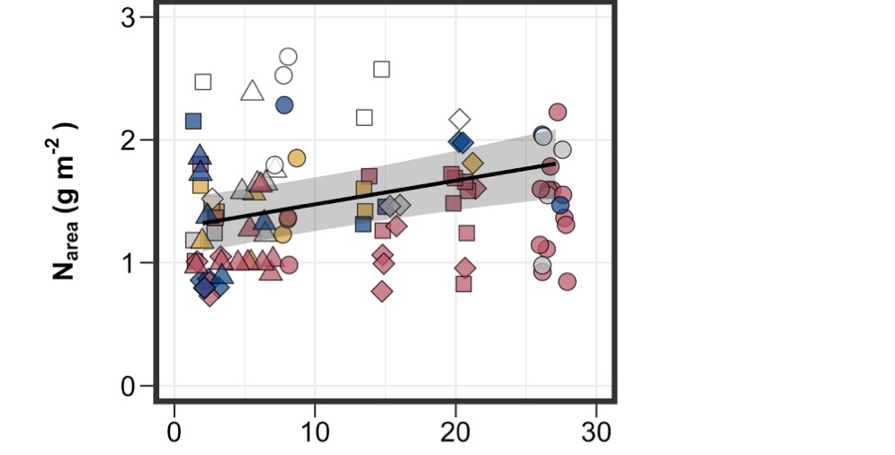
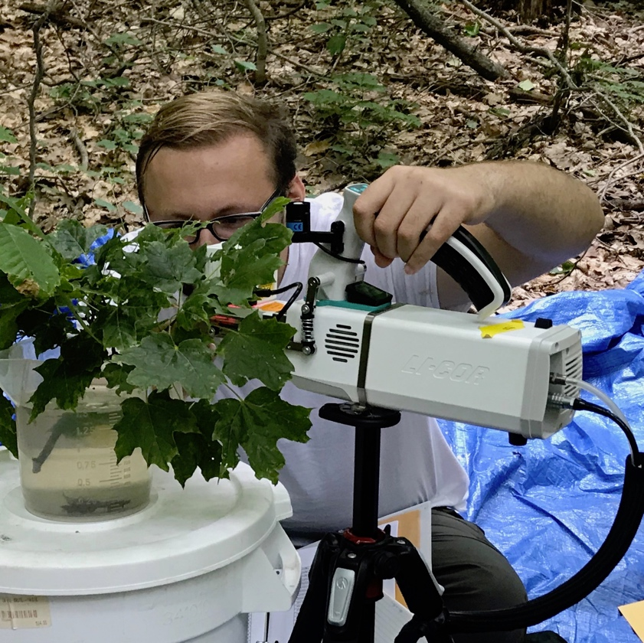
Result 3: Tissue N increases with increasing soil N
*Consistent across all studies
Perkowski,… and Smith (in review)

Slide 67
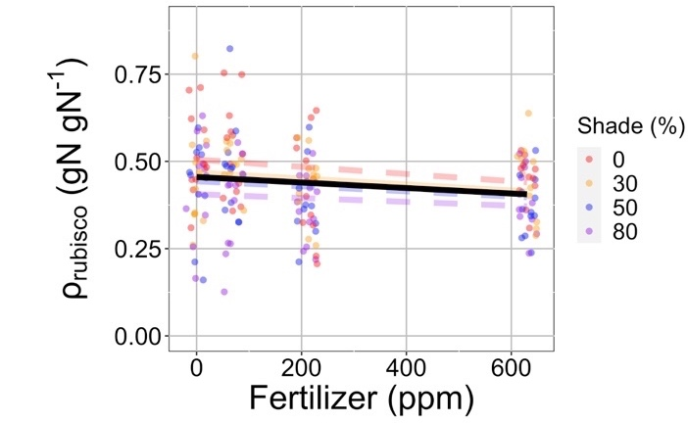
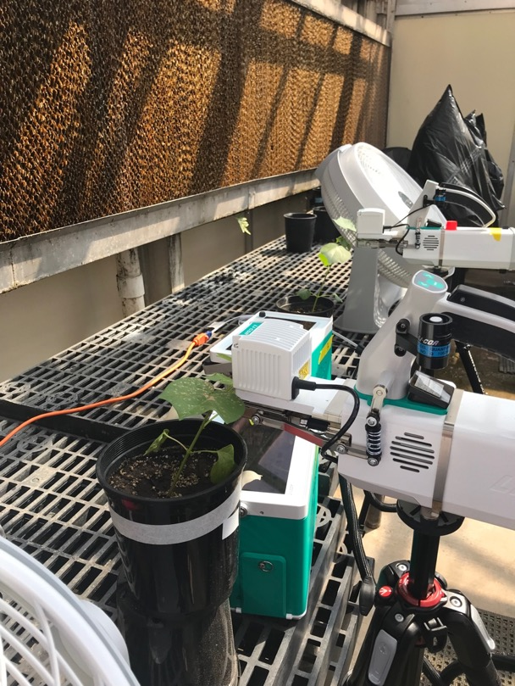
Result 4: Relative leaf N allocation to photosynthesis decreases with increasing soil N
*Consistent across multiple species, metrics, and growth conditions
Waring, Perkowski, and Smith (2023) J Exp Botany

Slide 68
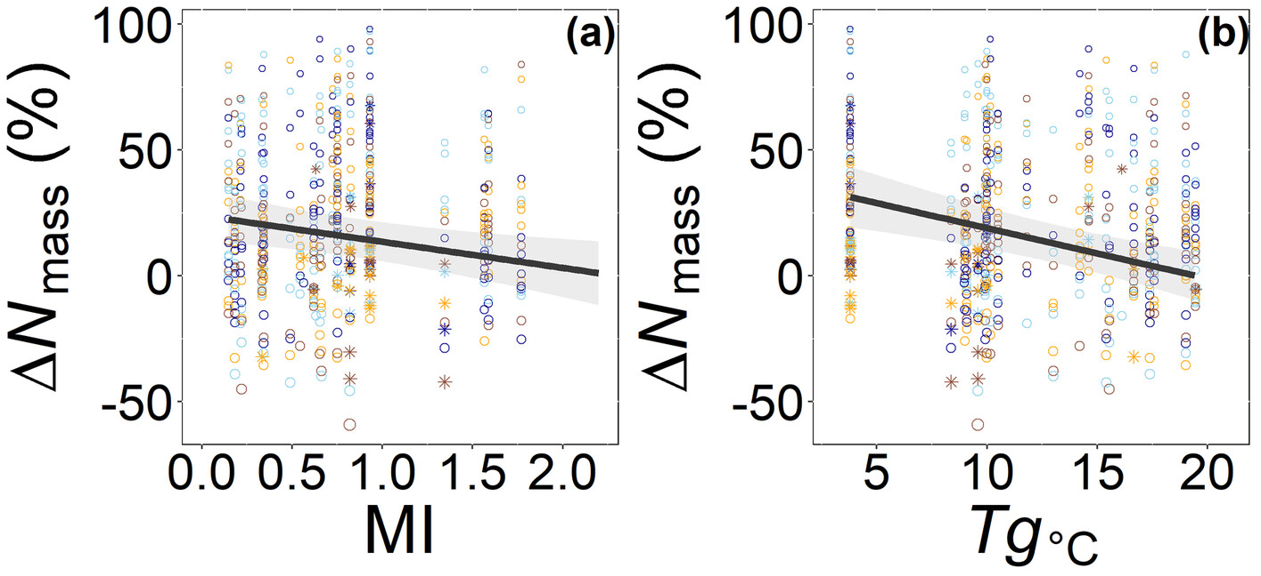
Result 5: Response to soil N is dependent on N demand
Cheaib,… and Smith (2025) New Phyt

Slide 69
Question 2: How do plants acclimate to soil nitrogen? Reduction in N uptake costs results in bigger plants with more leaf N, particularly where demand is high. However, more leaf N =/= more photosynthesis.

Slide 70
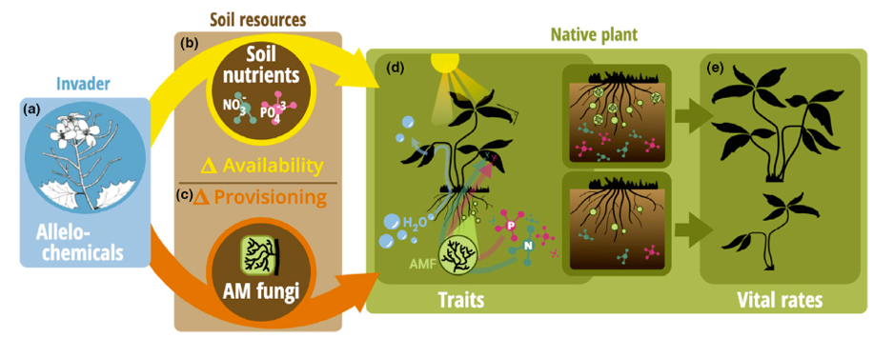
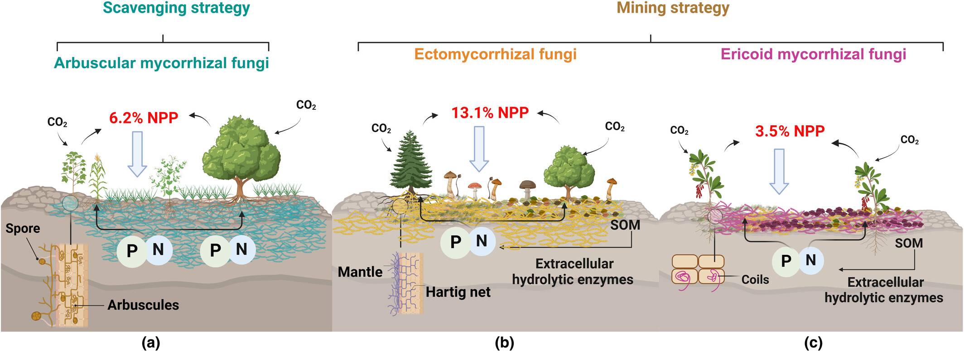
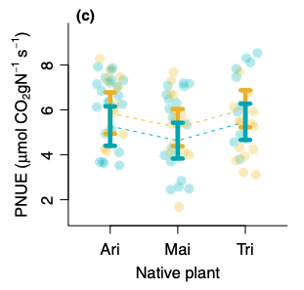
Looking forward: impact of soil resource acquisition strategies on leaf economics
Bialic-Murphy, Smith et al. (2021) Ecology Letters
Cheaib, Chieppa, Perkowski, and Smith (2025) New Phytologist

Slide 71
Question 3: What does acclimation mean for future terrestrial biogeochemical cycling?

Slide 72

Expected future responses
V_{cmax} decreases with CO₂ because of greater CO₂ in the leaf and less photorespiration
Smith et al. (2019) Ecol Letters

Slide 73
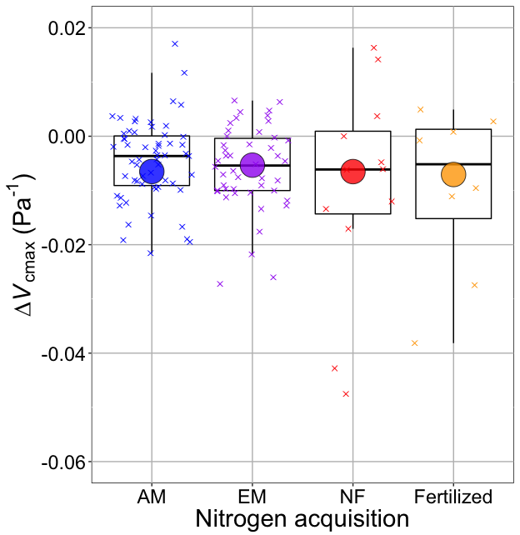
Smith and Keenan (2020) Glob Change Biol

Slide 74
V_{cmax} changes with CO₂ in ways expected from optimization
Boxes = data = -0.0063 Pa⁻¹
Circles = predicted = -0.0066 Pa⁻¹
Smith and Keenan (2020) Glob Change Biol

Slide 75
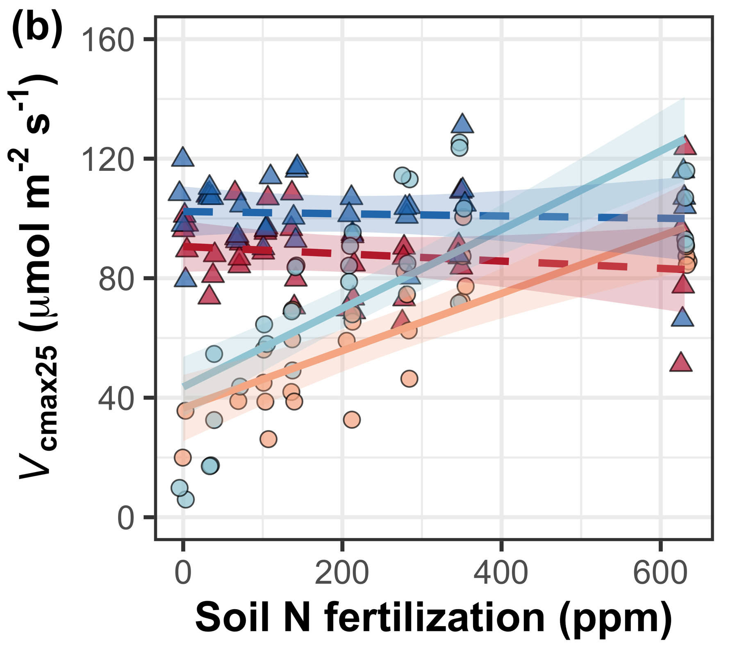

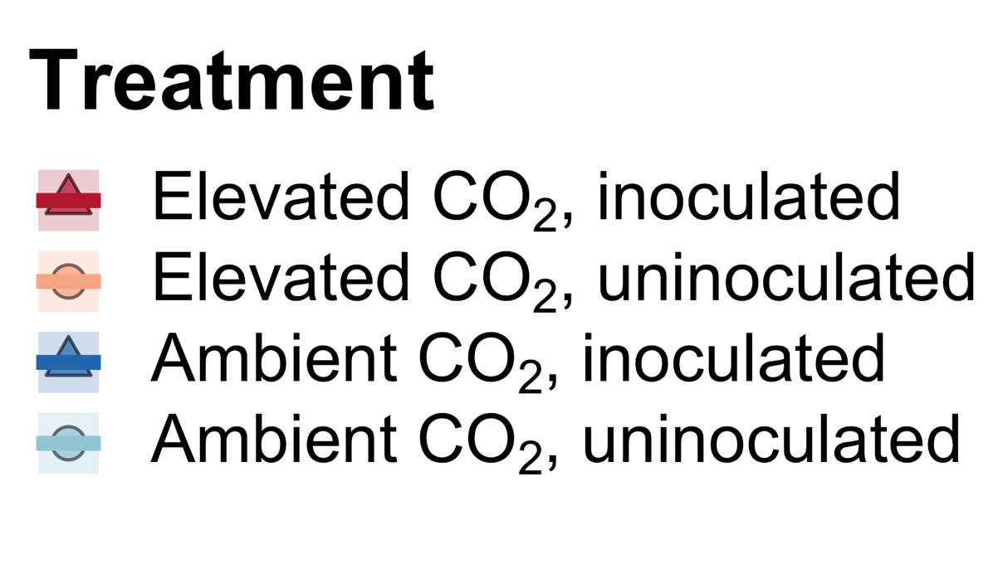

We further confirmed this universality of this response under 18 nitrogen by inoculation treatments
Perkowski, Ezekannagha, and Smith (2025) J Exp Botany

Slide 76
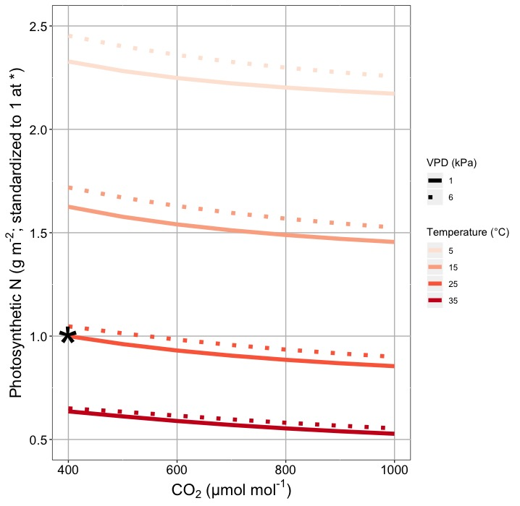
This generally suggests lower nitrogen demand under future conditions
Smith and Keenan (2020) Glob Change Biol

Slide 77

Let’s run a model out into the future!

Slide 78
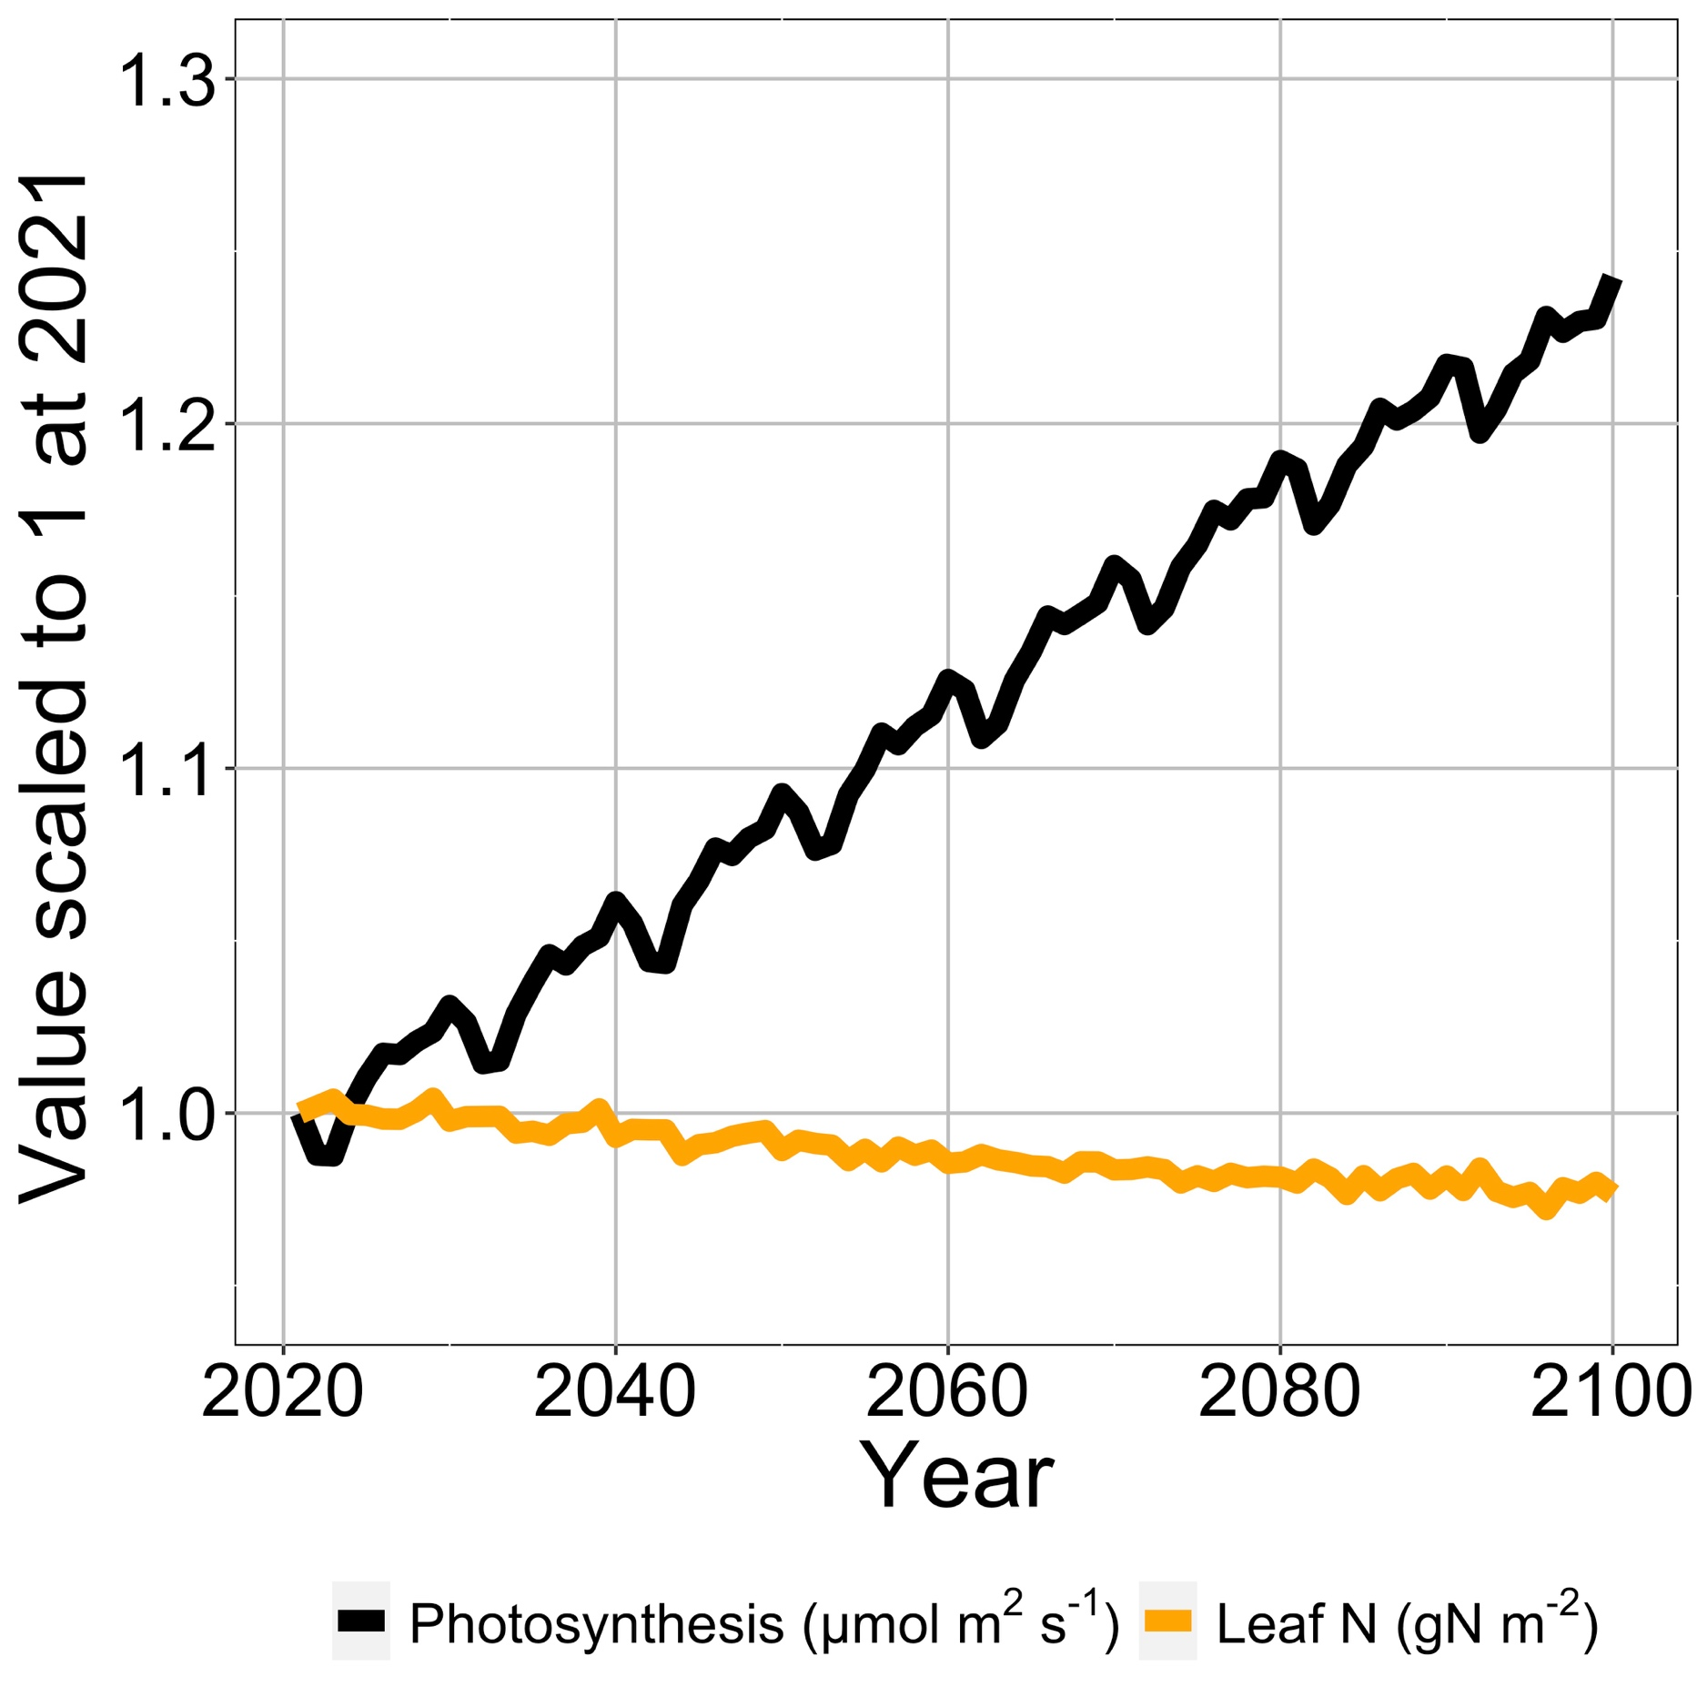
Photosynthesis increases with elevated CO₂ at lower leaf N
Smith et al. (2024) Glob Change Biol

Slide 79
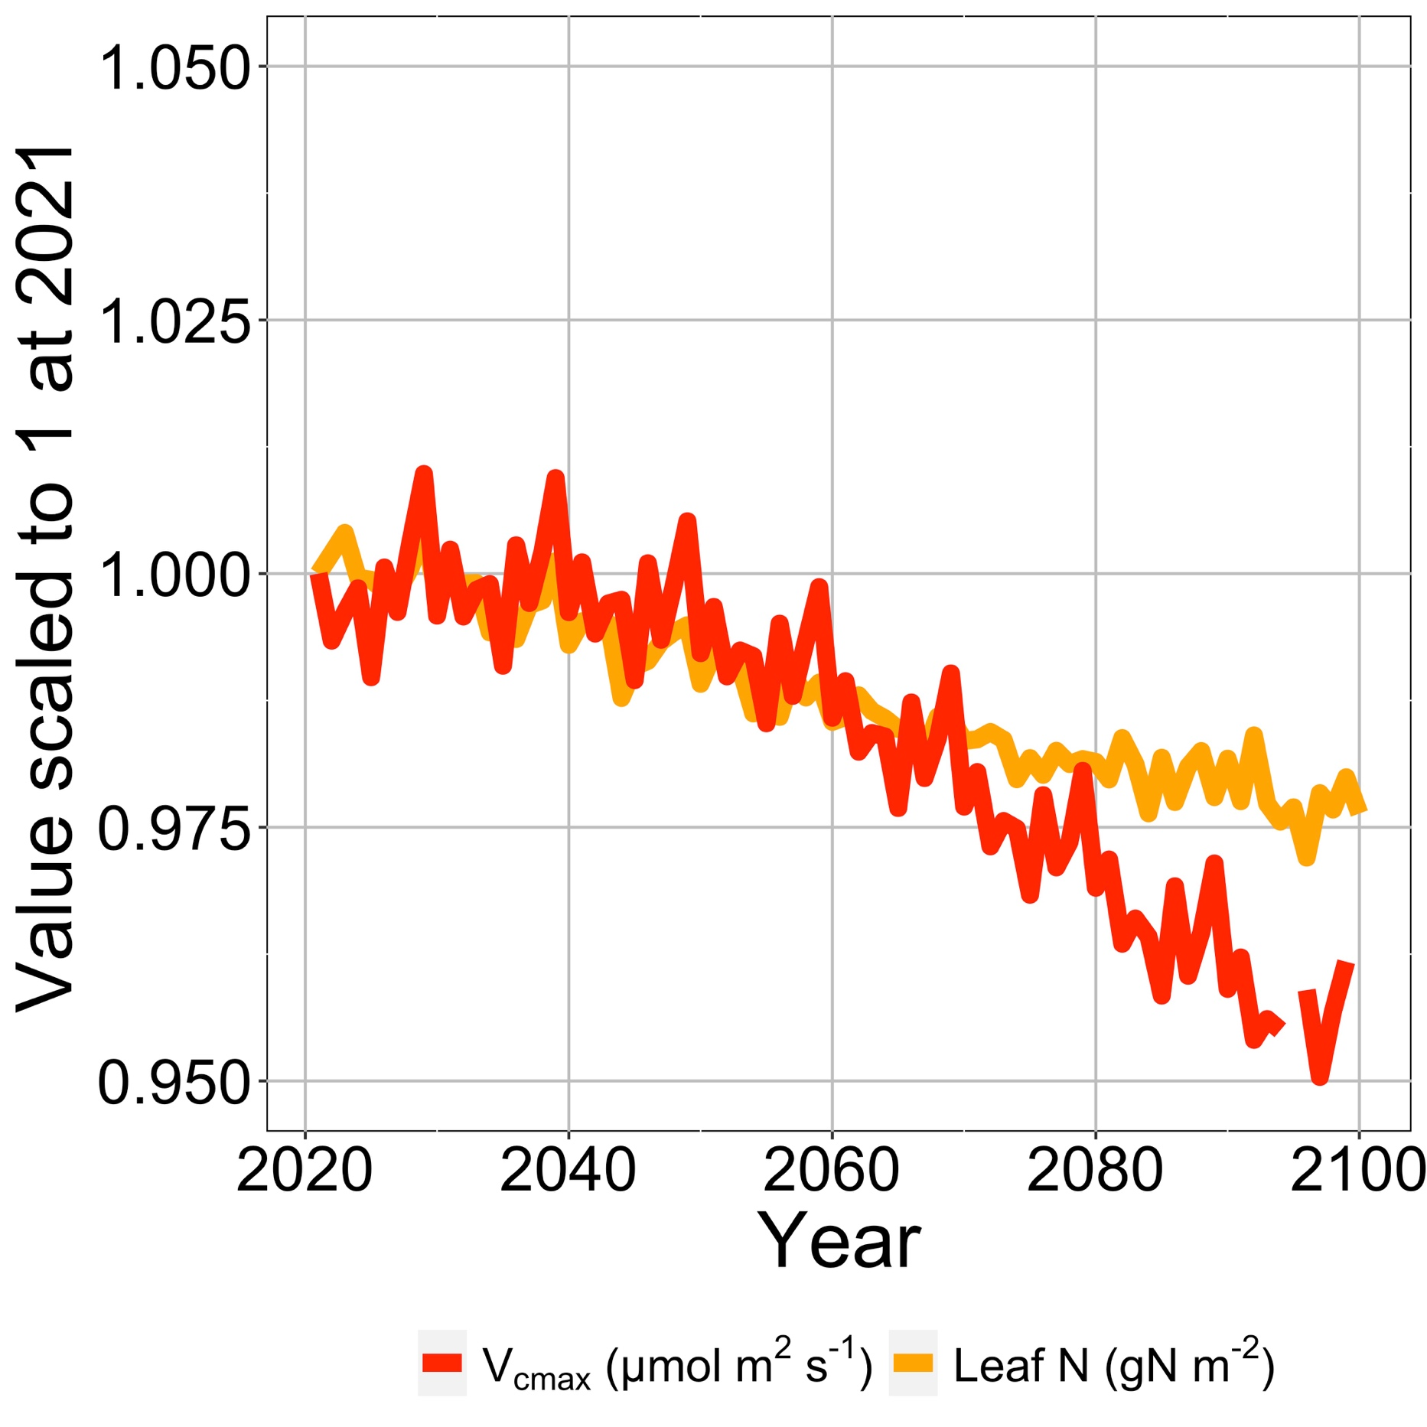
Leaf N reduction is due to a reduction in photosynthetic capacity
Smith et al. (2024) Glob Change Biol

Slide 80
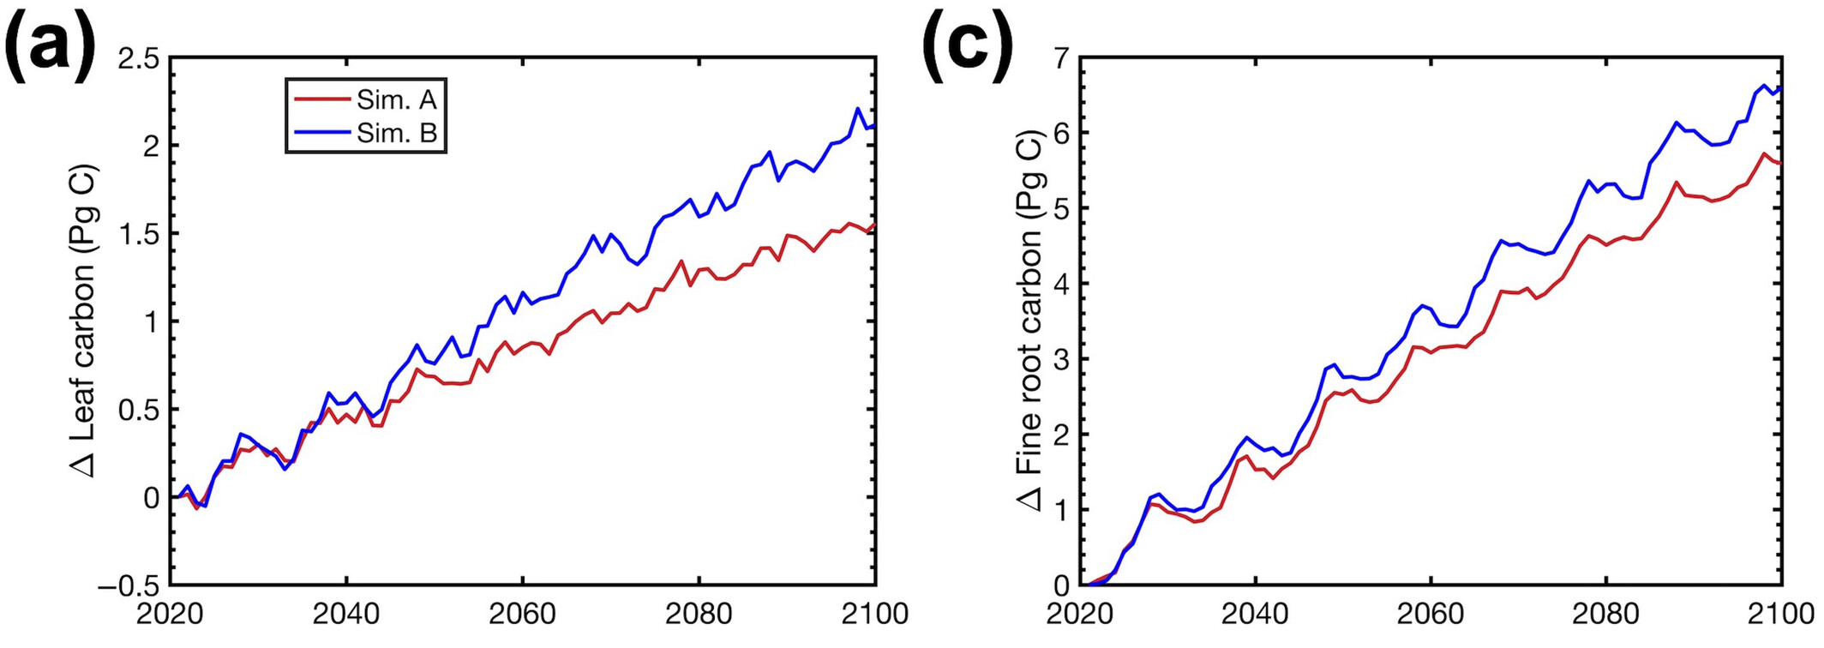
Plants build more leaves and fine roots
Smith et al. (2024) Glob Change Biol

Slide 81
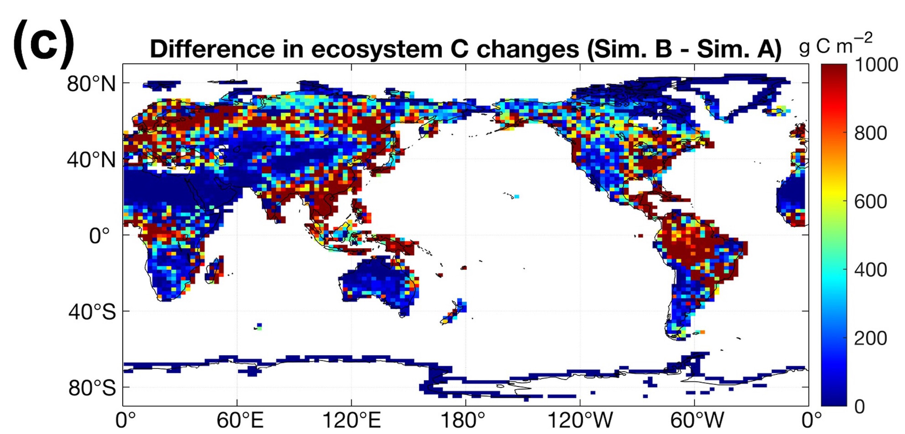
Leaf N savings increases long-term ecosystem carbon stocks
50% increase in ecosystem carbon from CO₂ acclimation
Smith et al. (2024) Glob Change Biol

Slide 82
Need to rethink nutrient limitation in models?
“No limitation” simulation
“Nutrient limitation” simulations
Weider et al. (2015)

Slide 83
Question 3: What does acclimation mean for future terrestrial biogeochemical cycling? Photosynthesis will increase and per-leaf-area nutrient use will decrease, reducing N limitation and increasing future ecosystem C

Slide 84
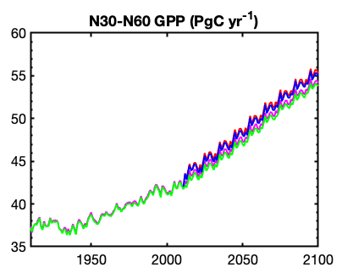
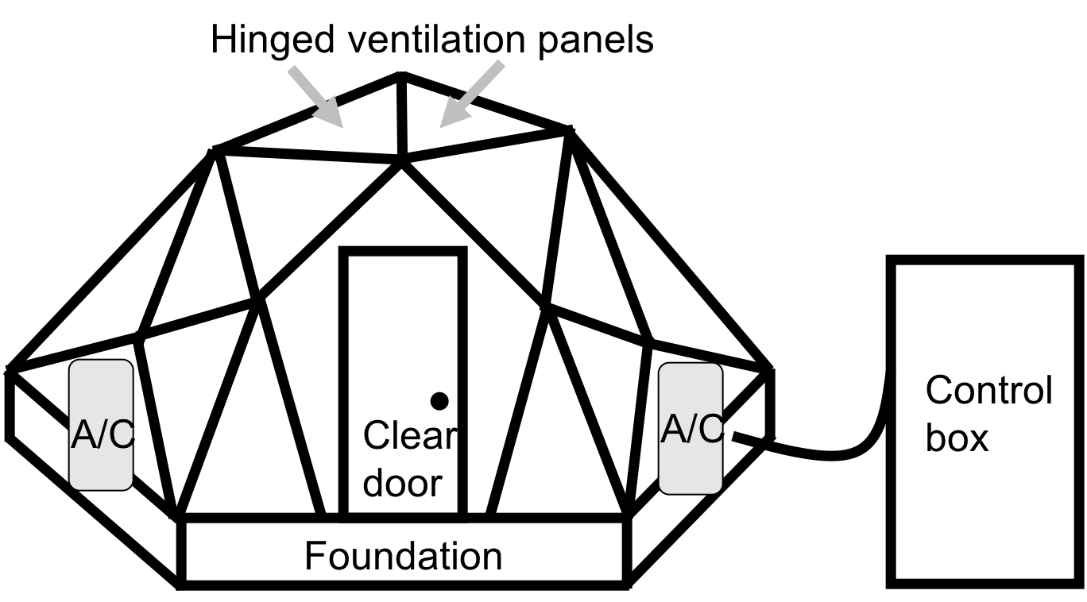
Looking forward: role of acclimation on future ecosystem feedbacks to global change
Coupled model-data experiments

Slide 85
Question 4: When is C₄ photosynthesis an advantage over C₃ photosynthesis?

Slide 86
C₃ versus C₄ optimization

Slide 87
C₄ versus C₃ optimization
C₄ photosynthesis has…
Little photorespiration
An additional limitation (PEP carboxylation)

Slide 88
C₄ versus C₃ optimization
C₄ photosynthesis has…
Little photorespiration
An additional limitation (PEP carboxylation)

Slide 89

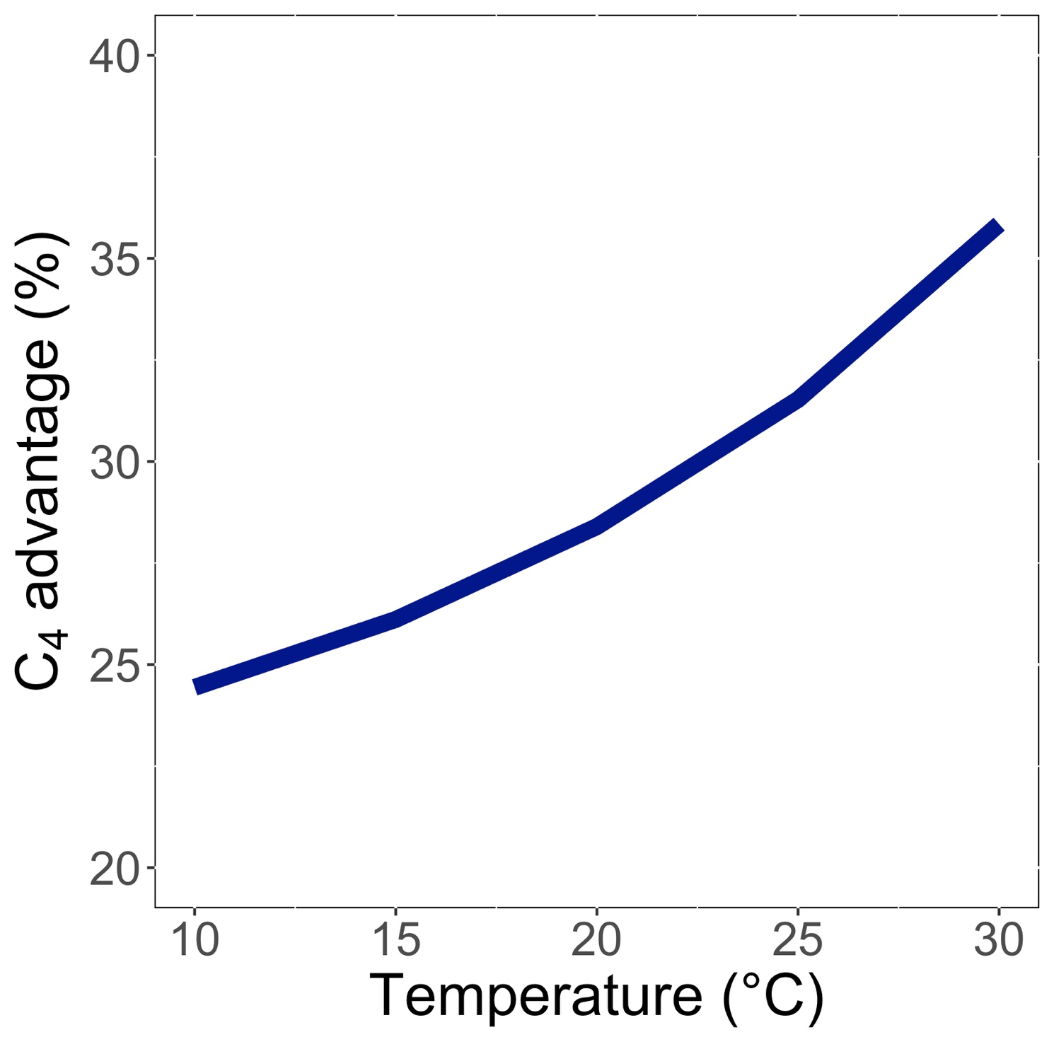
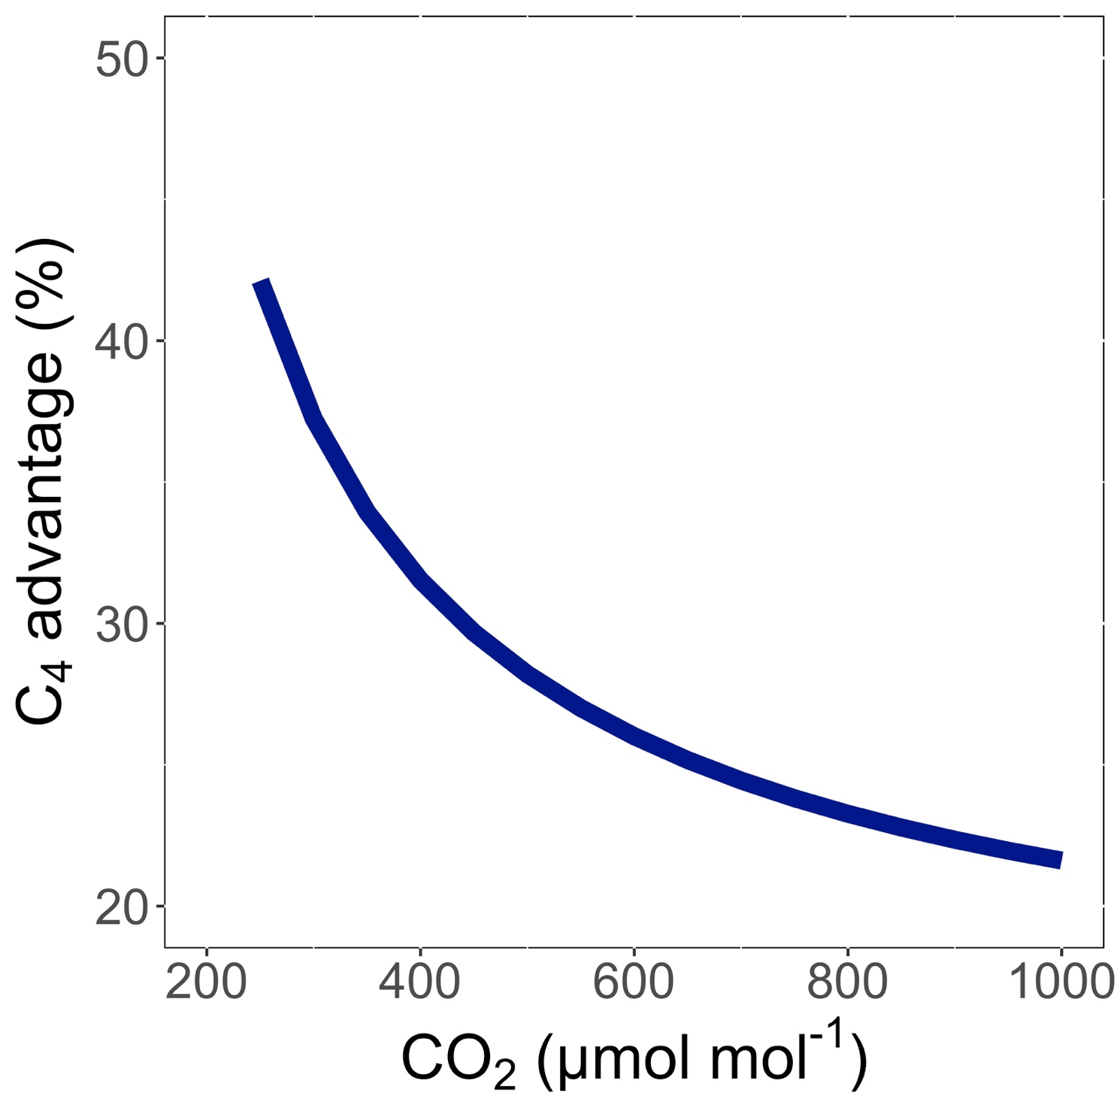
Relative advantage of C₄ physiology
Scott and Smith (2022) JAMES

Slide 90
Relative advantage of C₄ physiology
Scott and Smith (2022) JAMES

Slide 91
Relative advantage of C₄ physiology
Scott and Smith (2022) JAMES

Slide 92
The model seems to work!
Benefit of C₄ photosynthesis (%)
C₄ vegetation (%)
Scott and Smith (2022) JAMES

Slide 93

Ansley,… Smith et al. (2023) Ecosphere

Slide 94

Relative advantage of C₄ physiology may decrease in the future in the Southern Great Plains
Ansley,… Smith et al. (2023) Ecosphere

Slide 95

Similar responses further North
C₄ advantage (%)
Ansley,… Smith et al. (2023) Ecosphere

Slide 96
Question 4: When is C₄ photosynthesis an advantage over C₃ photosynthesis? C₄ is better in hot, dry, low CO₂ environments

Slide 97


Looking forward: scaling of C₄ biology from cells to biomes

Slide 98

Monson,…Smith et al. (2025) New Phyt

Slide 99
Conclusions

Slide 100
Conclusions
Plants aren’t dumb!
Assuming plants don’t dynamically respond to their environment can lead to poor understanding of ecological functioning from individuals to the Earth system
Dumb plants

Slide 101



Conclusions
Quantified physiological theory can:
Improve mechanistic understanding of physiological processes that underlie higher level responses
Produce more reliable future projections
f(x)
f(x)

Slide 102
And ultimately lead to a better understanding of how future ecosystem services will be impacts by global change

Slide 103

Presentation available at:
www.github.com/SmithEcophysLab/seminar/2025_unl
Data and code:
www.github.com/SmithEcophysLab
www.smithecophyslab.com/data
Thanks!

Slide 104



















Botanical Scaling
Core of ongoing and future projects
Interdisciplinary Science
Atmo., Physics, Chemistry, Media & Coms
Open Science
IntBio (Funded)
CAREER (Funded)
BII (In Review)
LEMONTREE (Funded)
Integration
Teaching and Research
CUREs, Methods Courses, Field Experiences
Service and Research
Department, University, Nation

Slide 105
Botanical Scaling
Core of ongoing and future projects
IntBio (Funded)
CAREER (Funded)
BII (In Review)
Integration

Slide 106
Interdisciplinary Science
Atmo., Physics, Chemistry, Media & Coms
Open Science
LEMONTREE (Funded)
Integration

Slide 107
Integration
Teaching and Research
CUREs, Methods Courses, Field Experiences

Slide 108
Integration
Service and Research
Department, University, Nation

